Slide 1
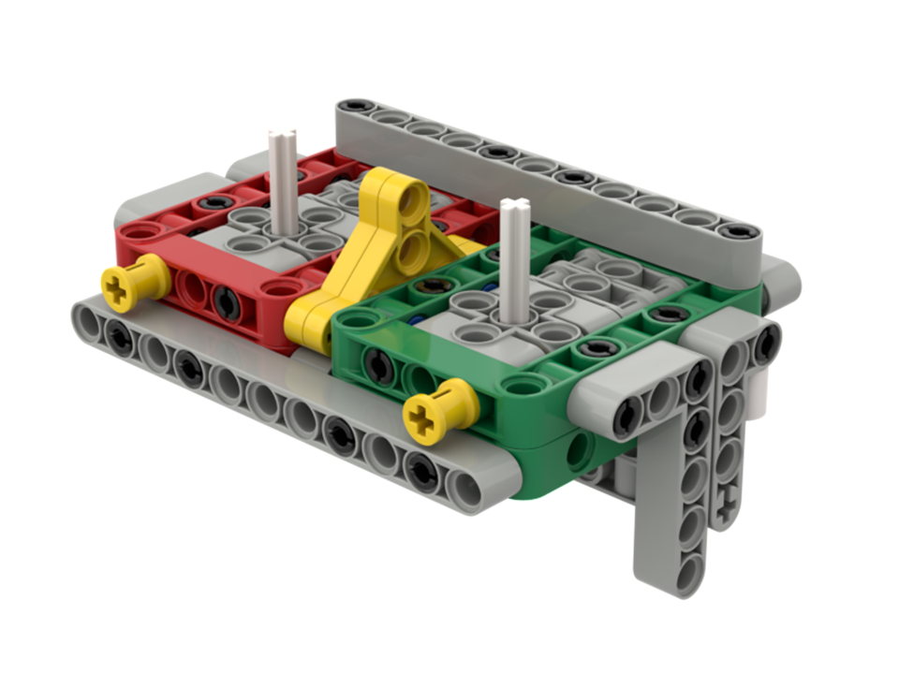
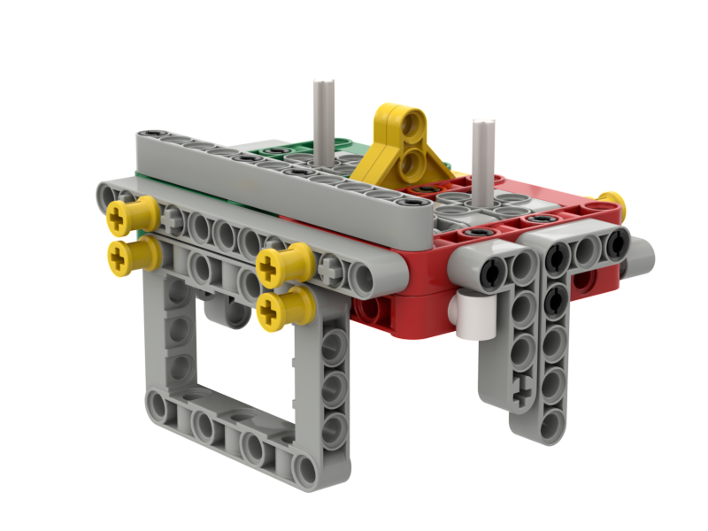
Step 1 - Base Attachments Unearthed

Slide 2
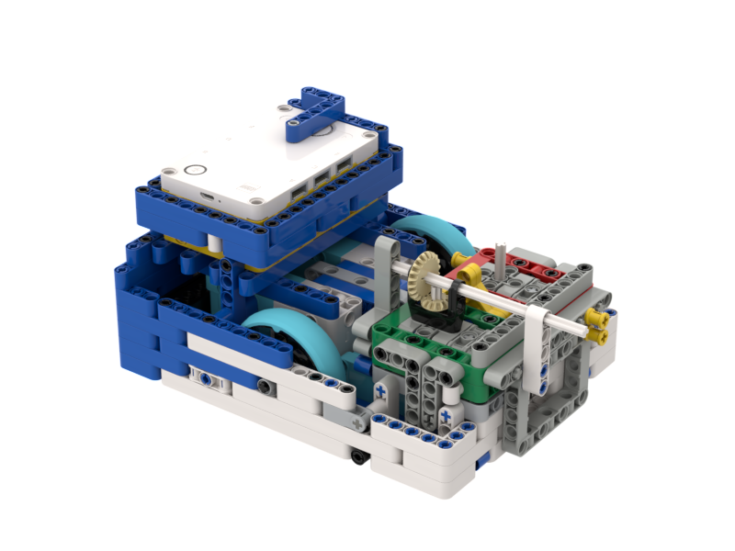
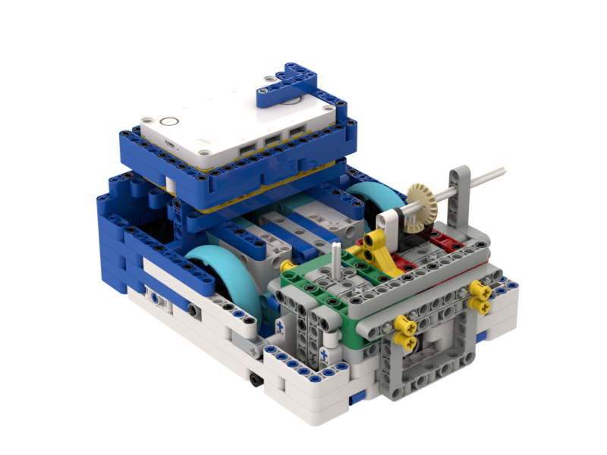
Base Attachment Step One
We build all of our attachments so they are universal and can simply drop in place. But these instructions will only get you so far. You have some decisions to make.
For example, which way do you need your axles to point? You could have both axles sticking out the front. Or you could have both sticking out the sides. Or you could have one of each. Or you could have only one axle. You may need an axle point straight up. You can switch the red and green. It's all up to you.
Also, you have to decide what gear ratio you want to use. Do you need more torque or more speed? We have options!
Before you go any further, think about where you want your axles and how strong your attachment needs to be when you are done. Talk to a coach if you aren't sure.
Forward

Slide 3
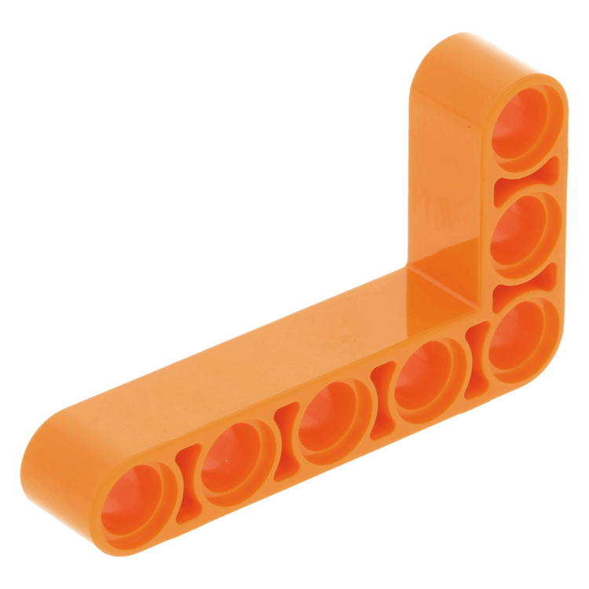
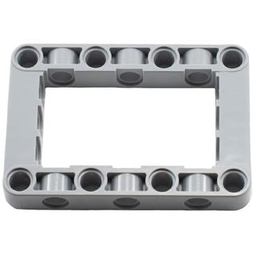
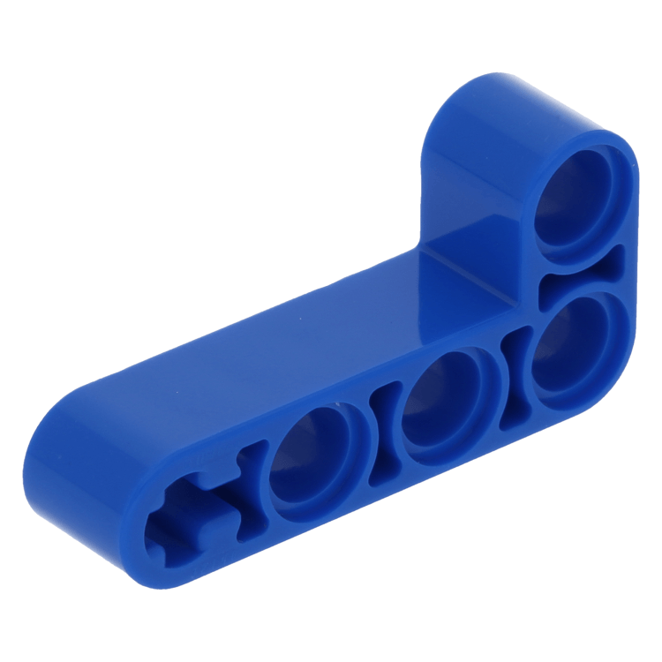
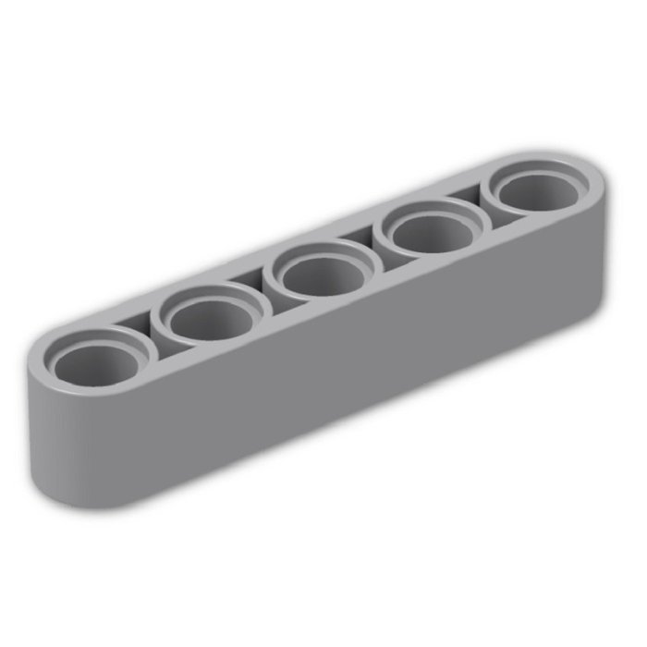
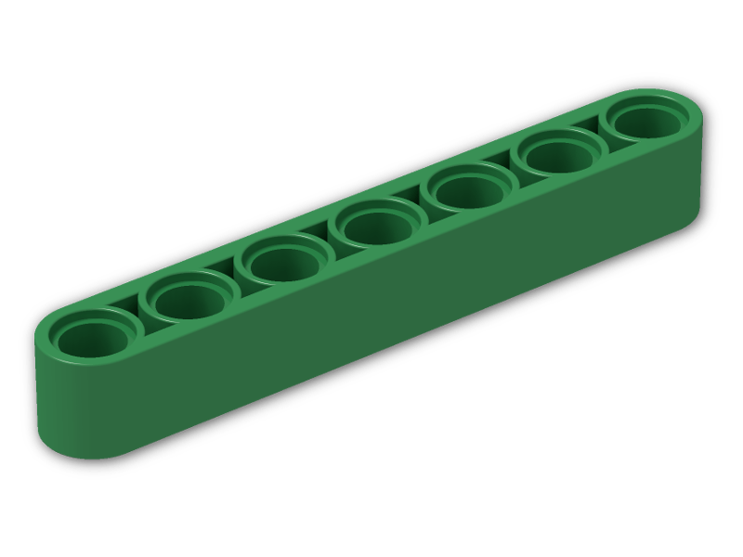
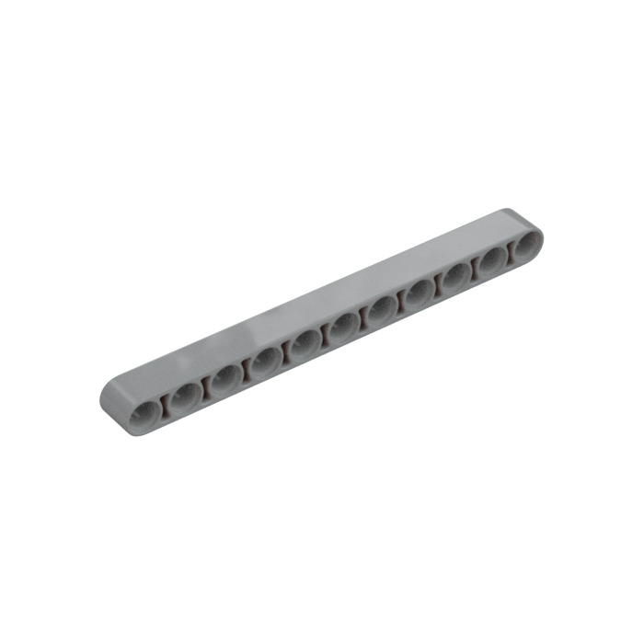
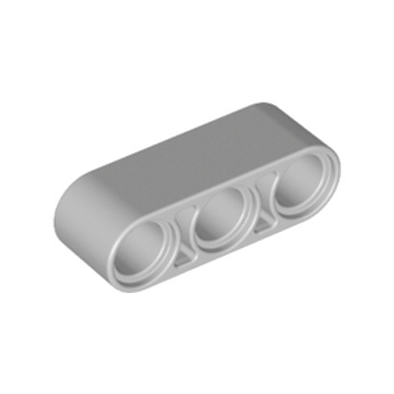
What you will need
Pick up one of the attachment bins and your colored bin of parts
You will also need (5) frames
For left-right axles, you will need (1-2) 3-beams
You will need a “final” axle of whatever length you need. Each application is different, so you need to figure out what the correct length is for you
Black pins, long blue pins, and bushings as needed
2- 4
5
2- 4
1-2
1
2
1-2

Slide 4
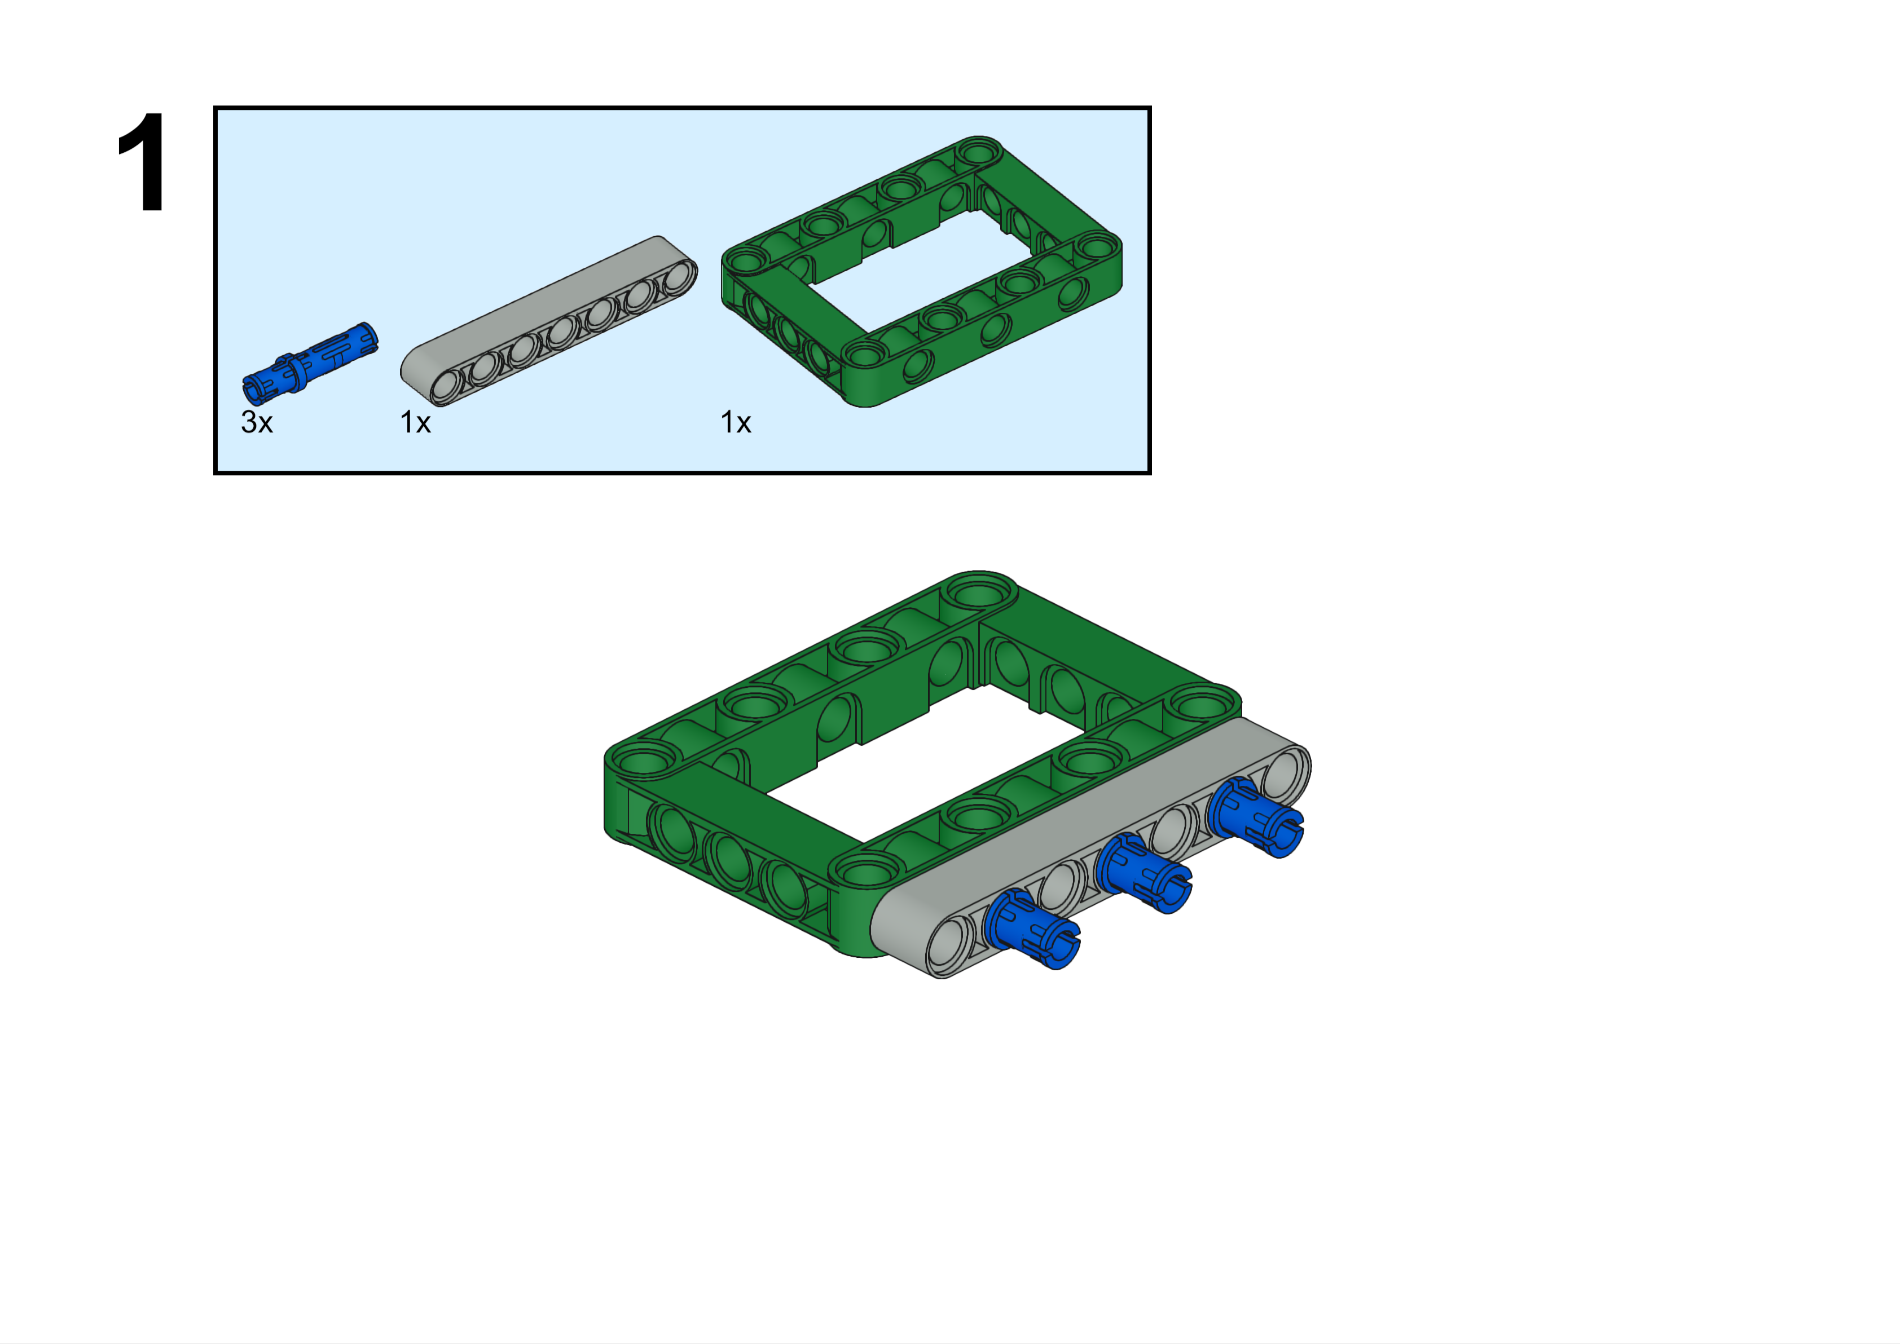
These are the "Build Plate" build instructions. All of your attachments will start with this. It is then up to you to figure out what else you need on your attachment. Everything will attach to this. You will not be able to "pin attach" anything directly to the robot, with one rare exception.
7L
This beam is seven studs long. We call it a seven-beam.
The large piece is called a "frame". It is five by seven studs. The blue peg is three studs long. You will be using these pieces a lot with your robot. You should have these pieces in your colored bin of parts, but we have more in storage if you need them.
This is called a "beam", but Lego usually calls them "liftarms". You can get this piece from your colored bin of parts. They come in sizes from three to fifteen studs in length, but all odd numbers. However, there is one even numbered beam. Do you know which one? Hint: this is sort of a trick question. By the way, we also have "beams" that are one stud long. We call them "one-beams"

Slide 6
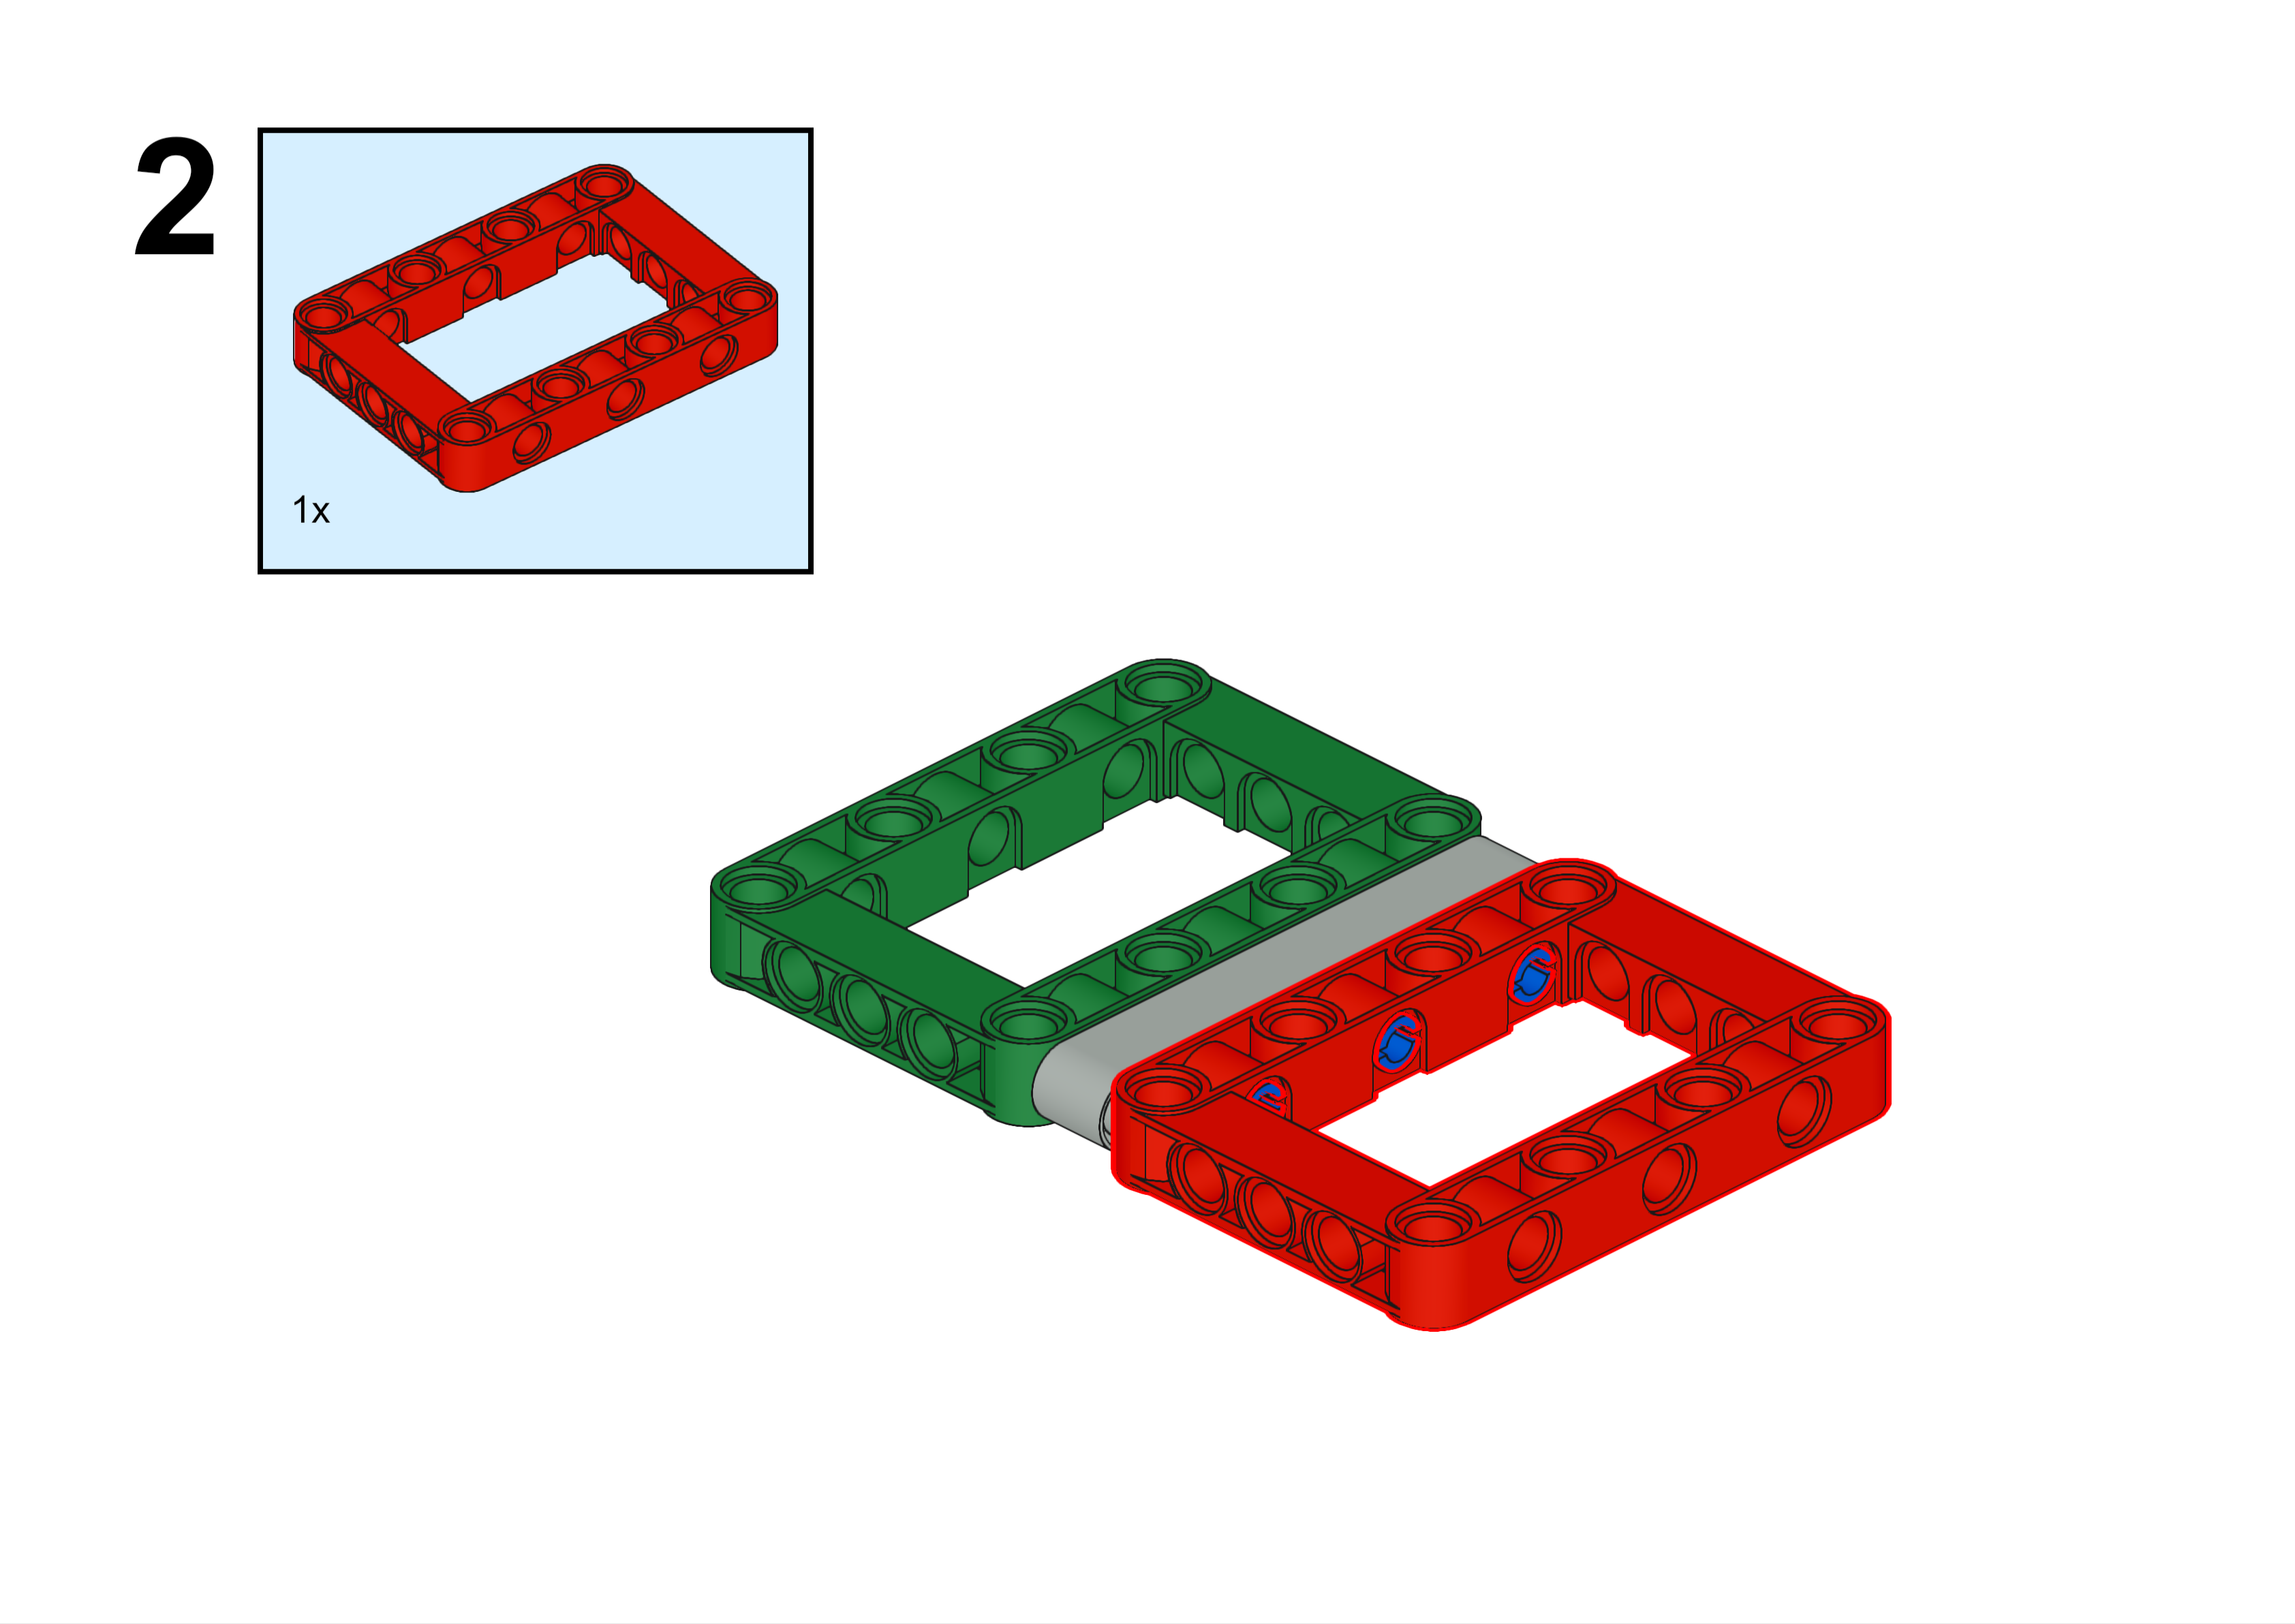

Slide 7
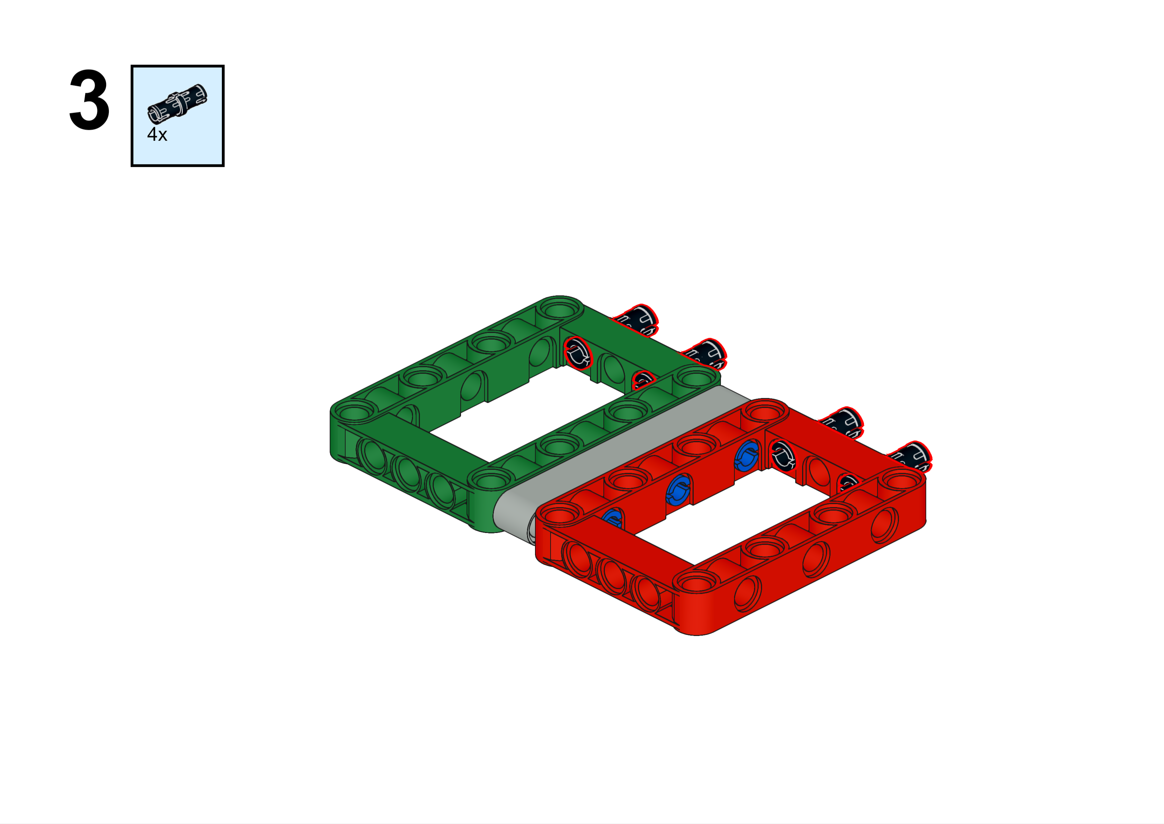
Ahhh.. the black peg. We have over six thousand of them in bins but there is probably one on the floor right now!

Slide 8
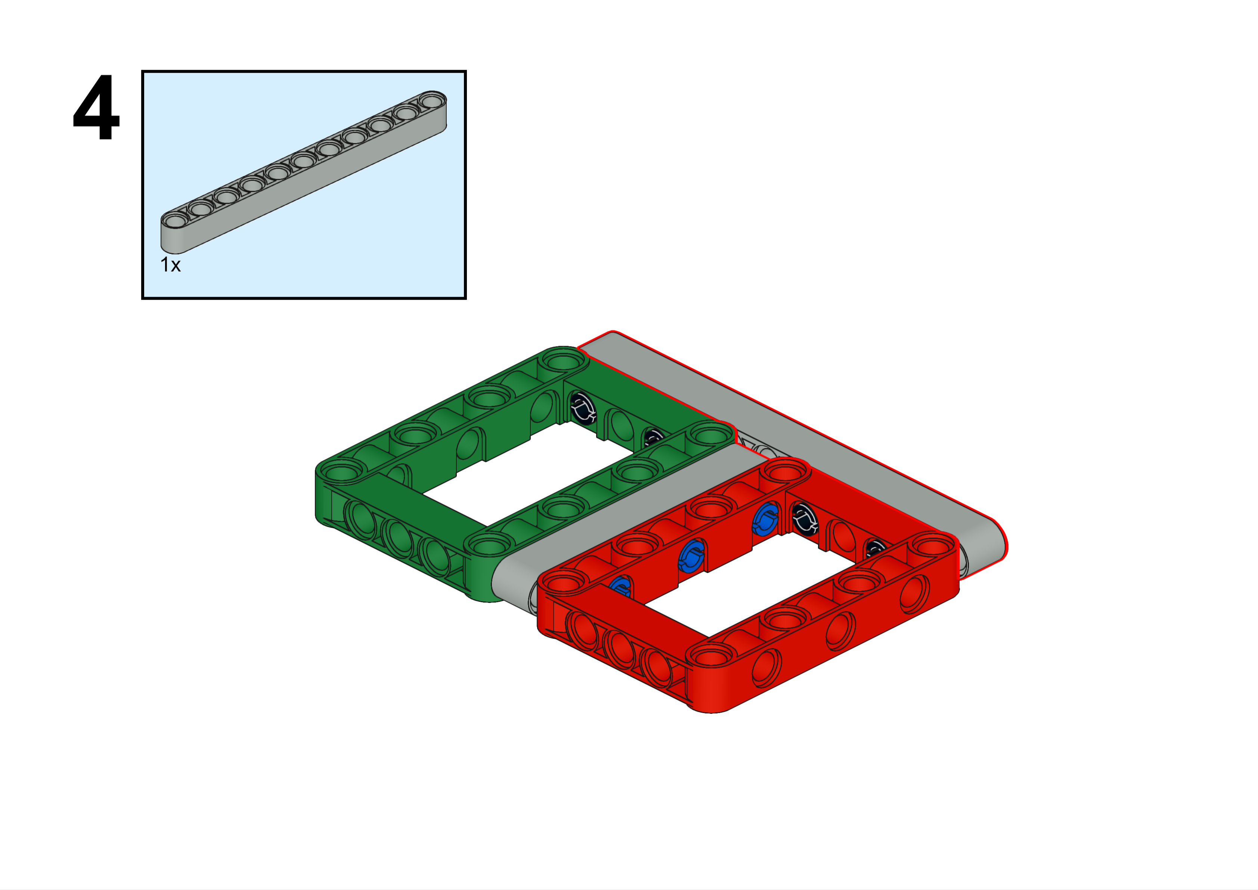
11L

Slide 9
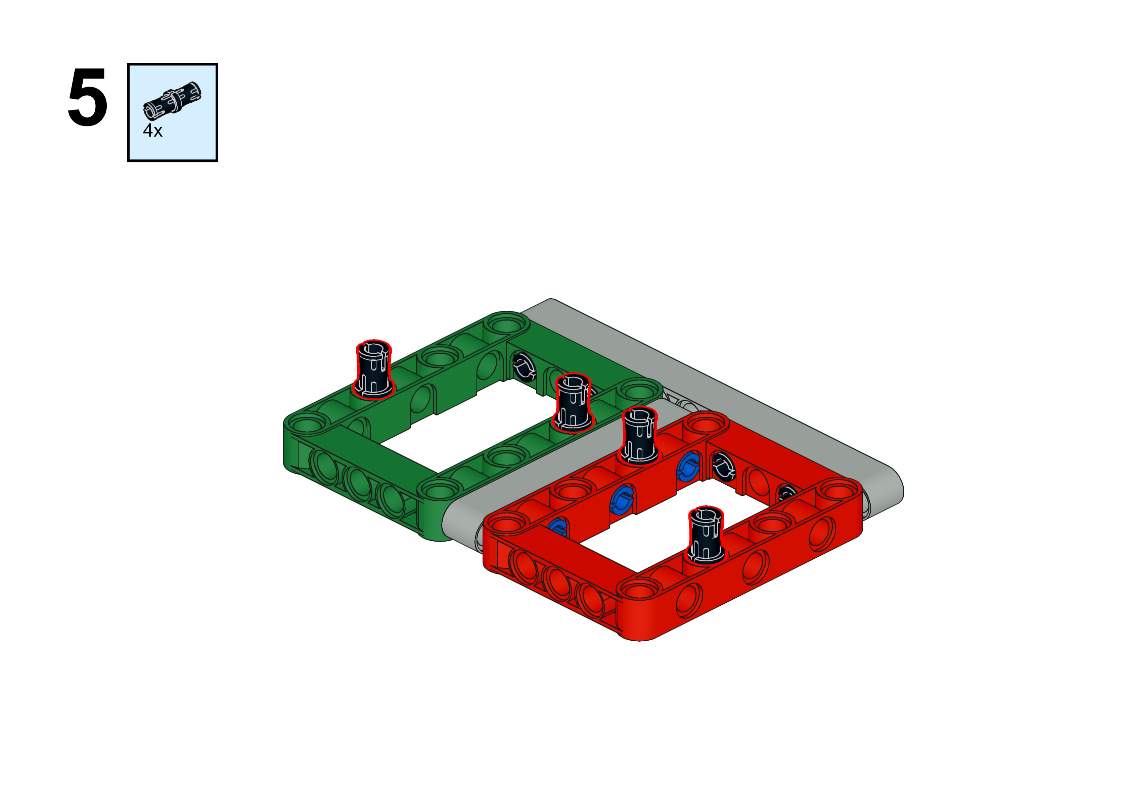

Slide 10
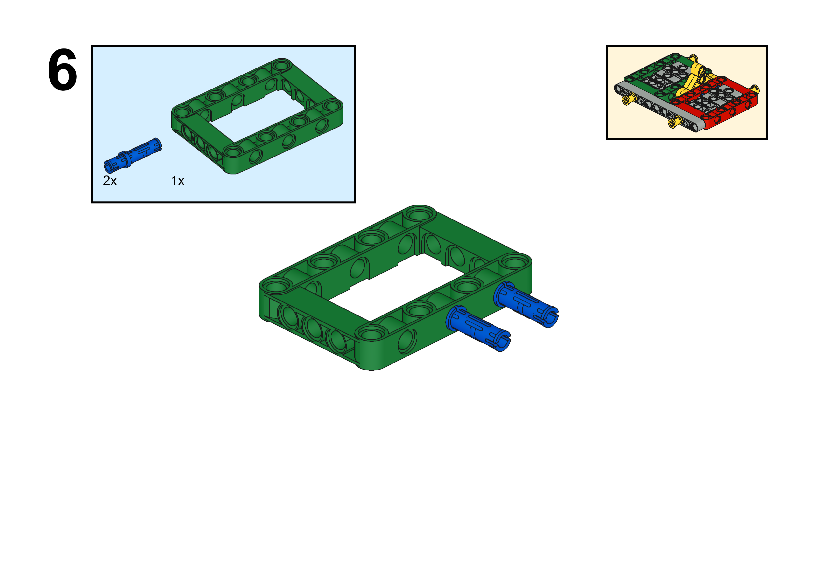

Slide 11
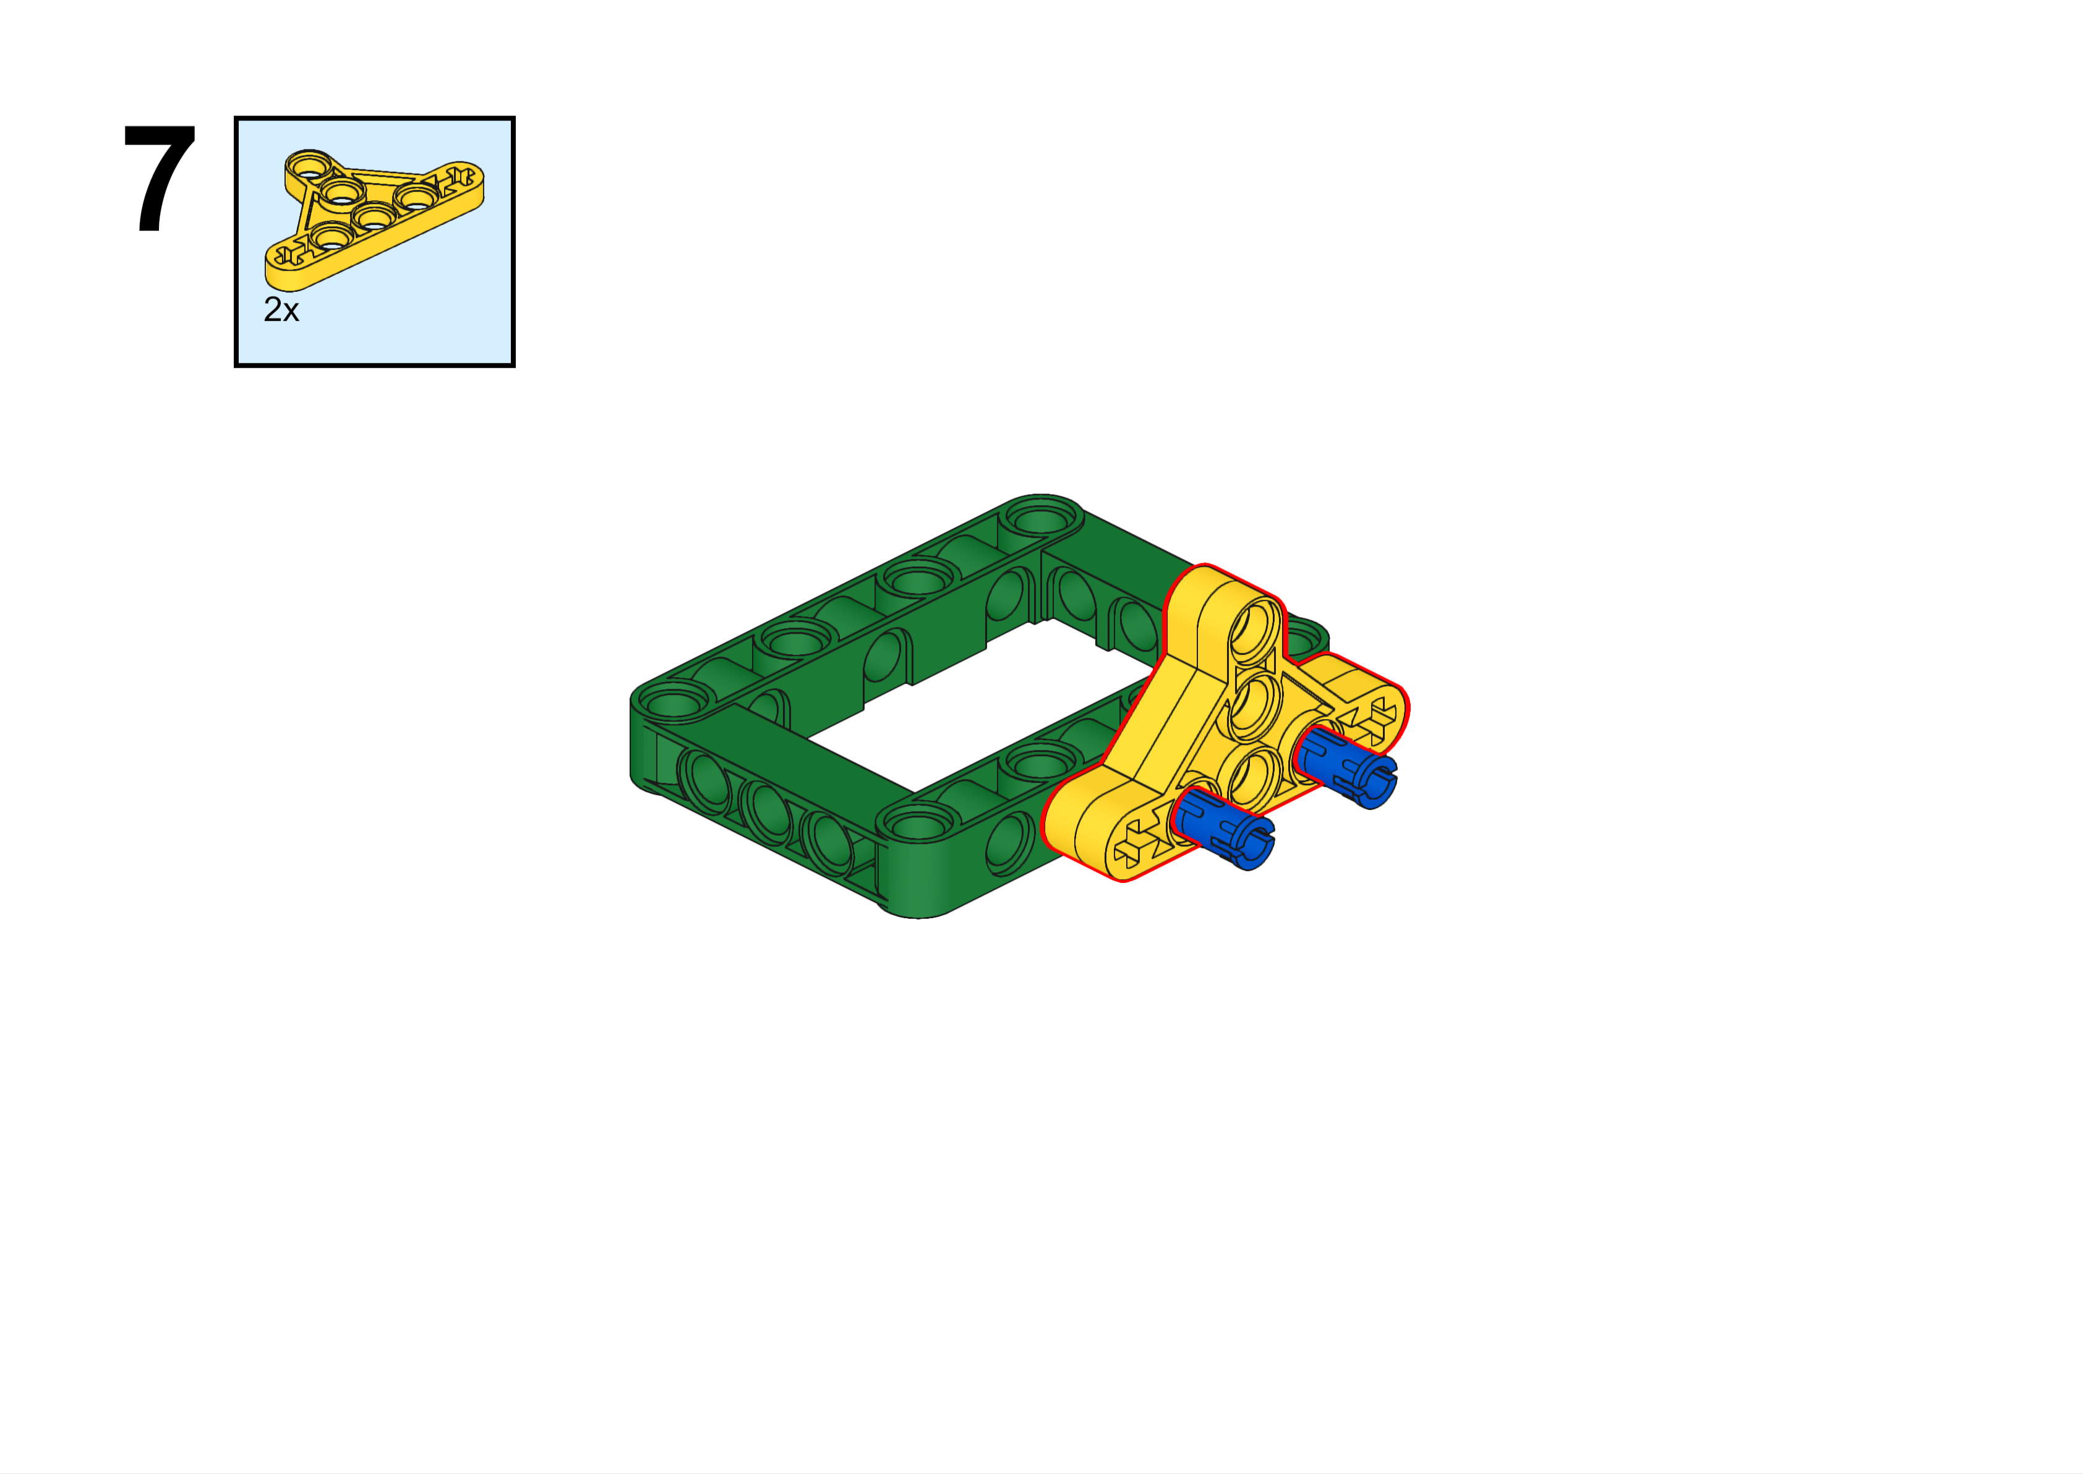

Slide 12
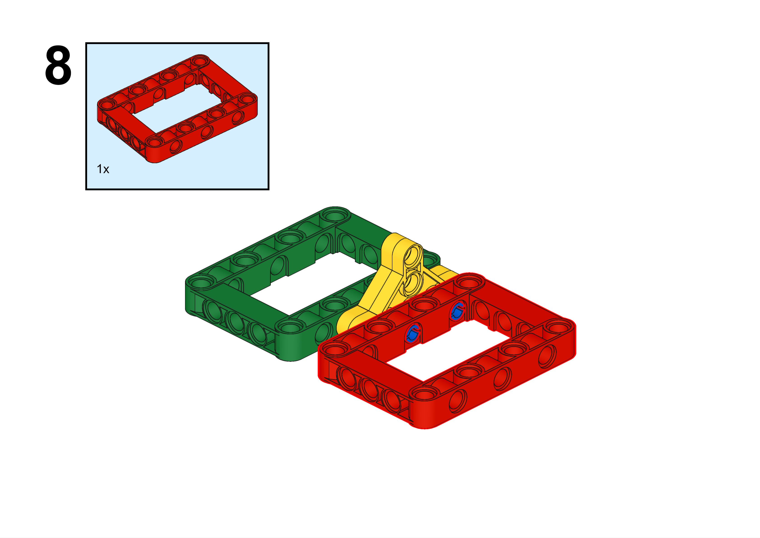

Slide 13
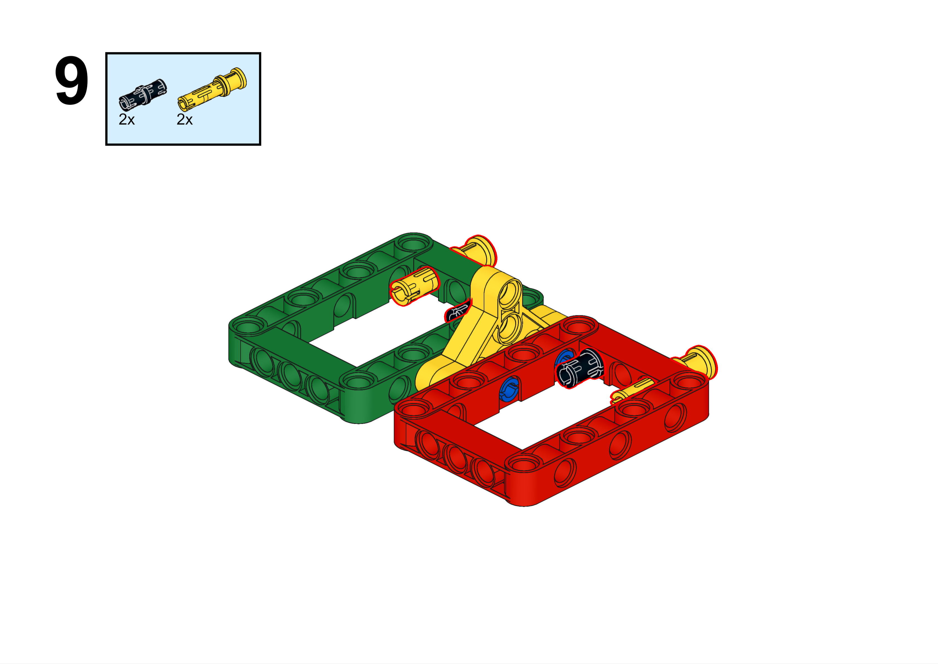
We call this yellow piece a “push pin”.

Slide 14
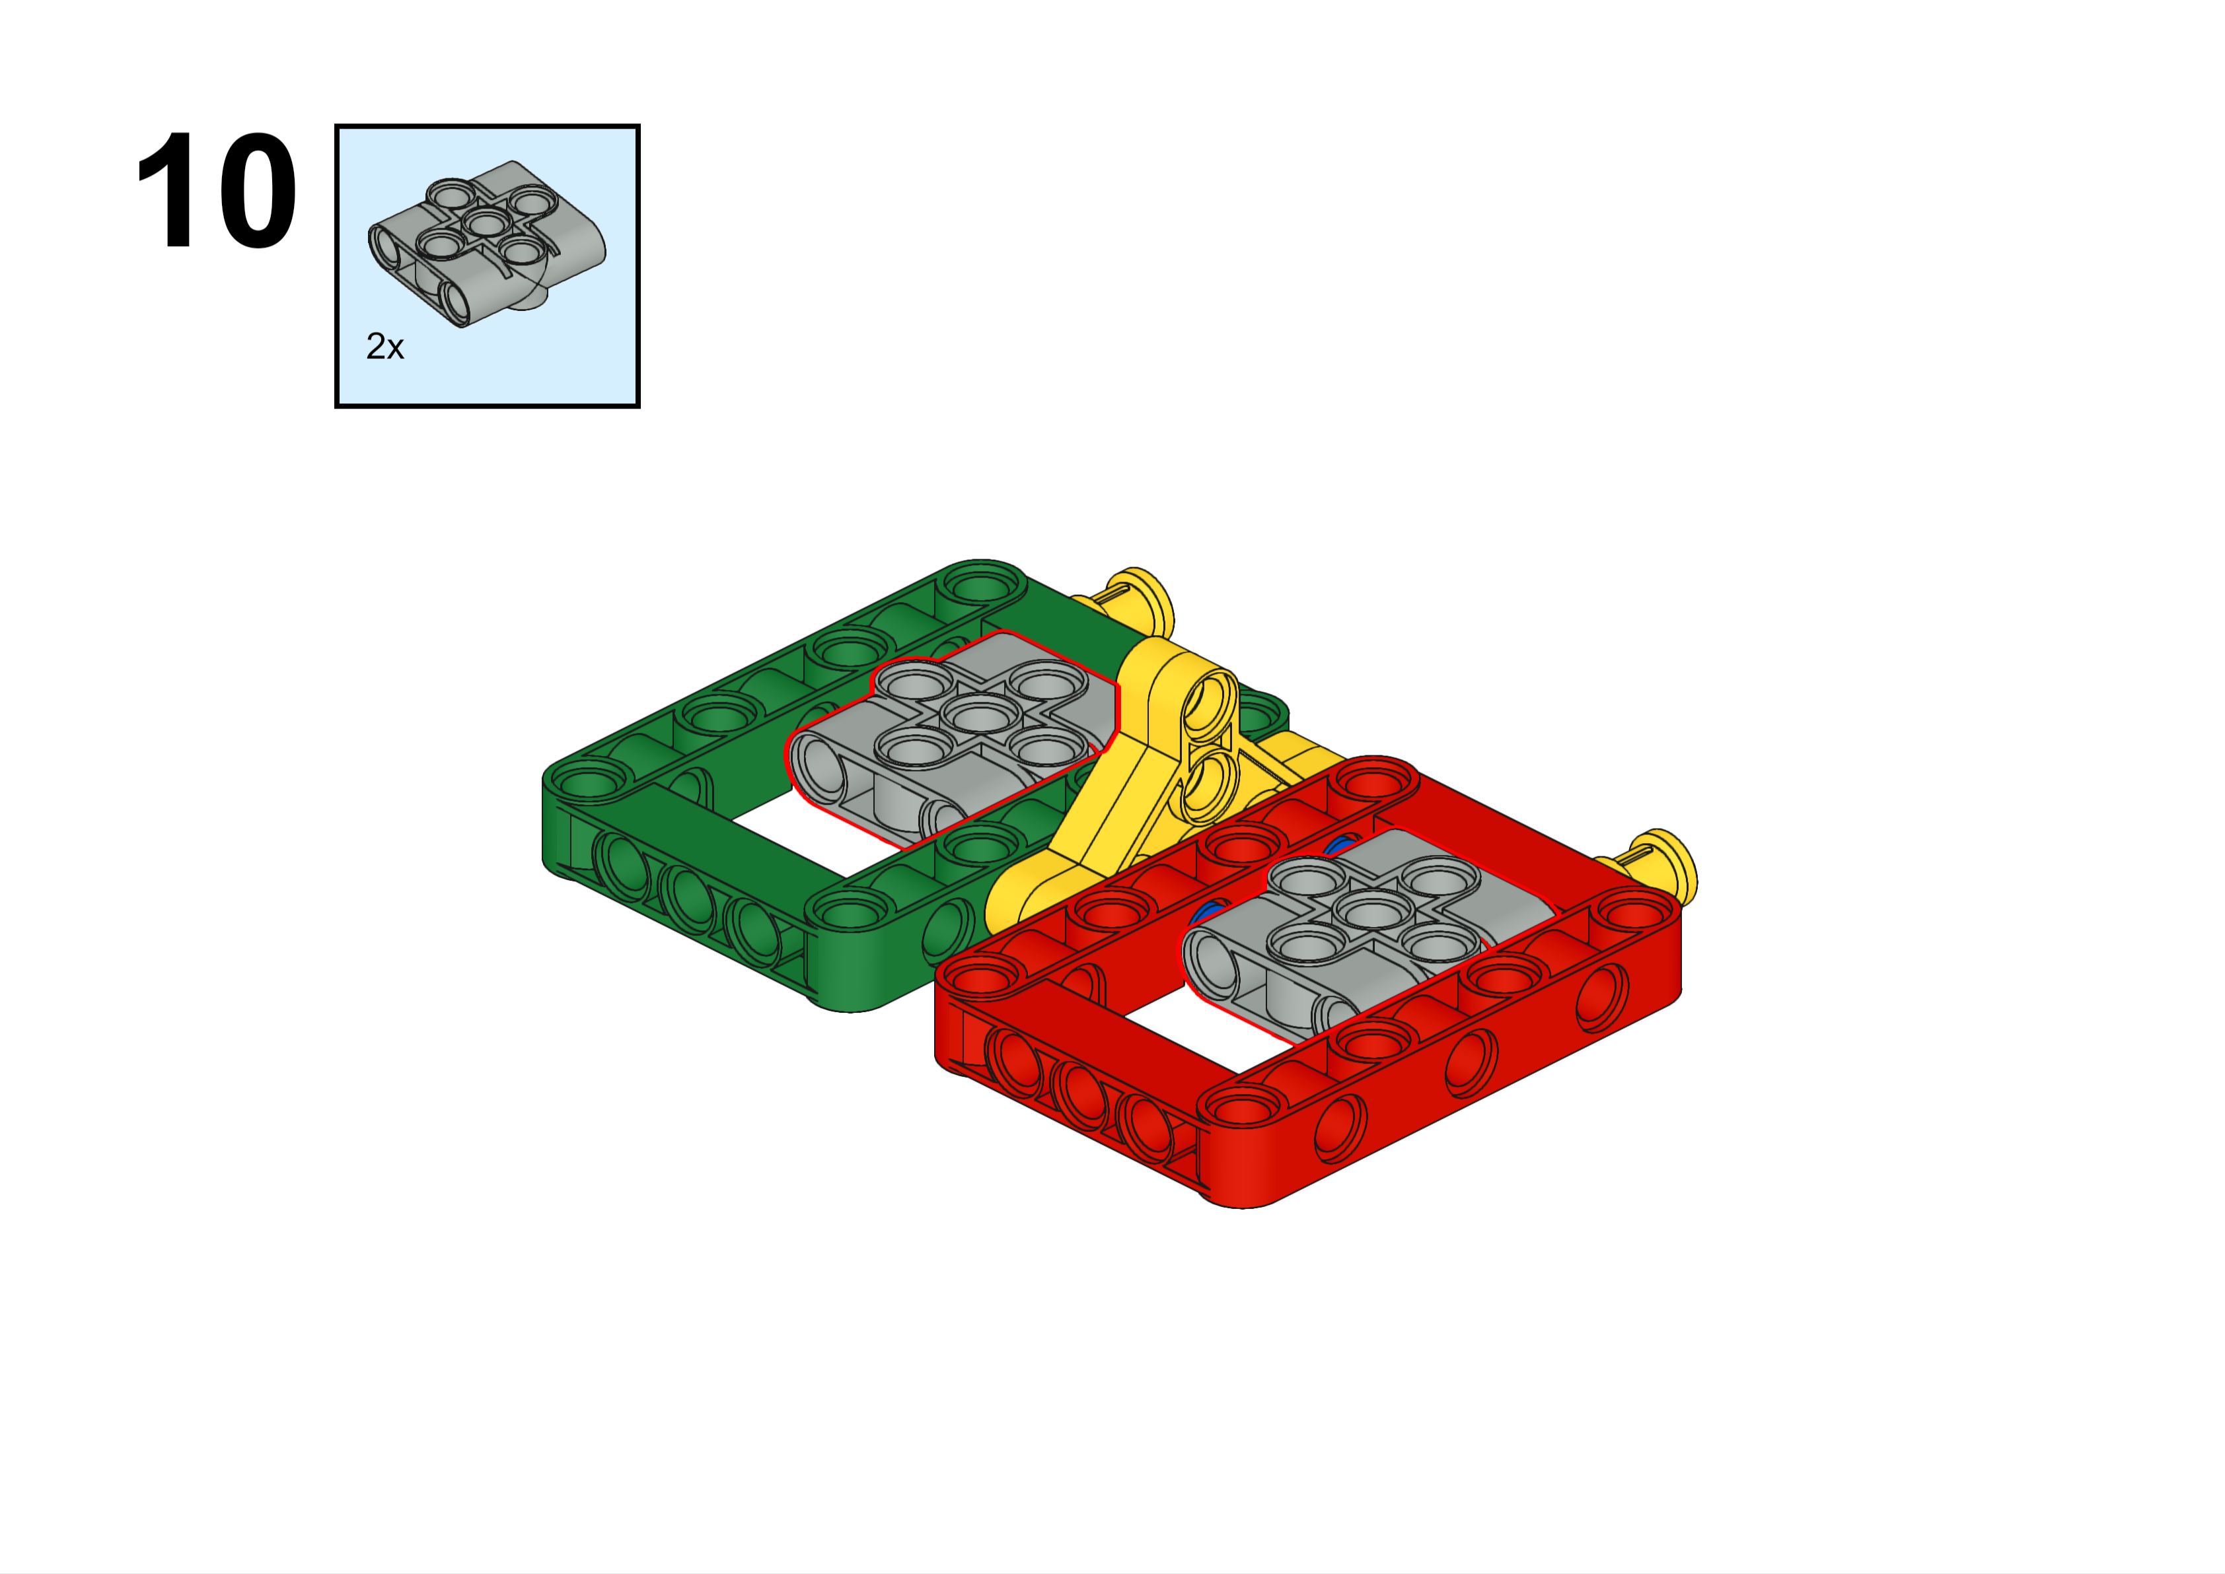

Slide 15
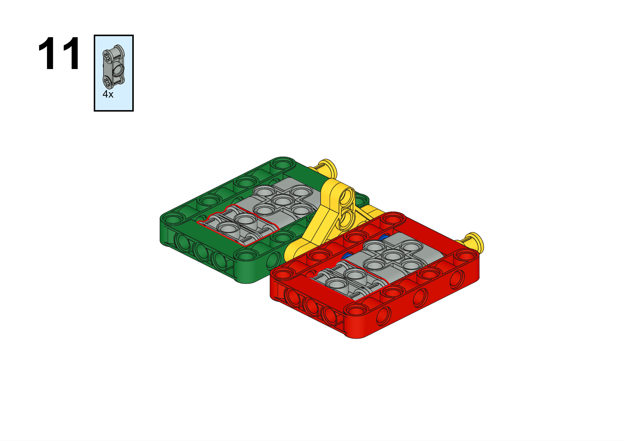
These won’t stay in place until you complete the next step. So just get the pieces you need for now.

Slide 16

This piece is called an "axle". We normally use them to connect rotating pieces, but in this case we are using them for structure and support. Axles come in sizes from two to twelve studs in length, plus some other really long ones. We have all kinds of connectors to make any size or shape you need.
5L
Axles will stick out here just like the picture shows

Slide 17
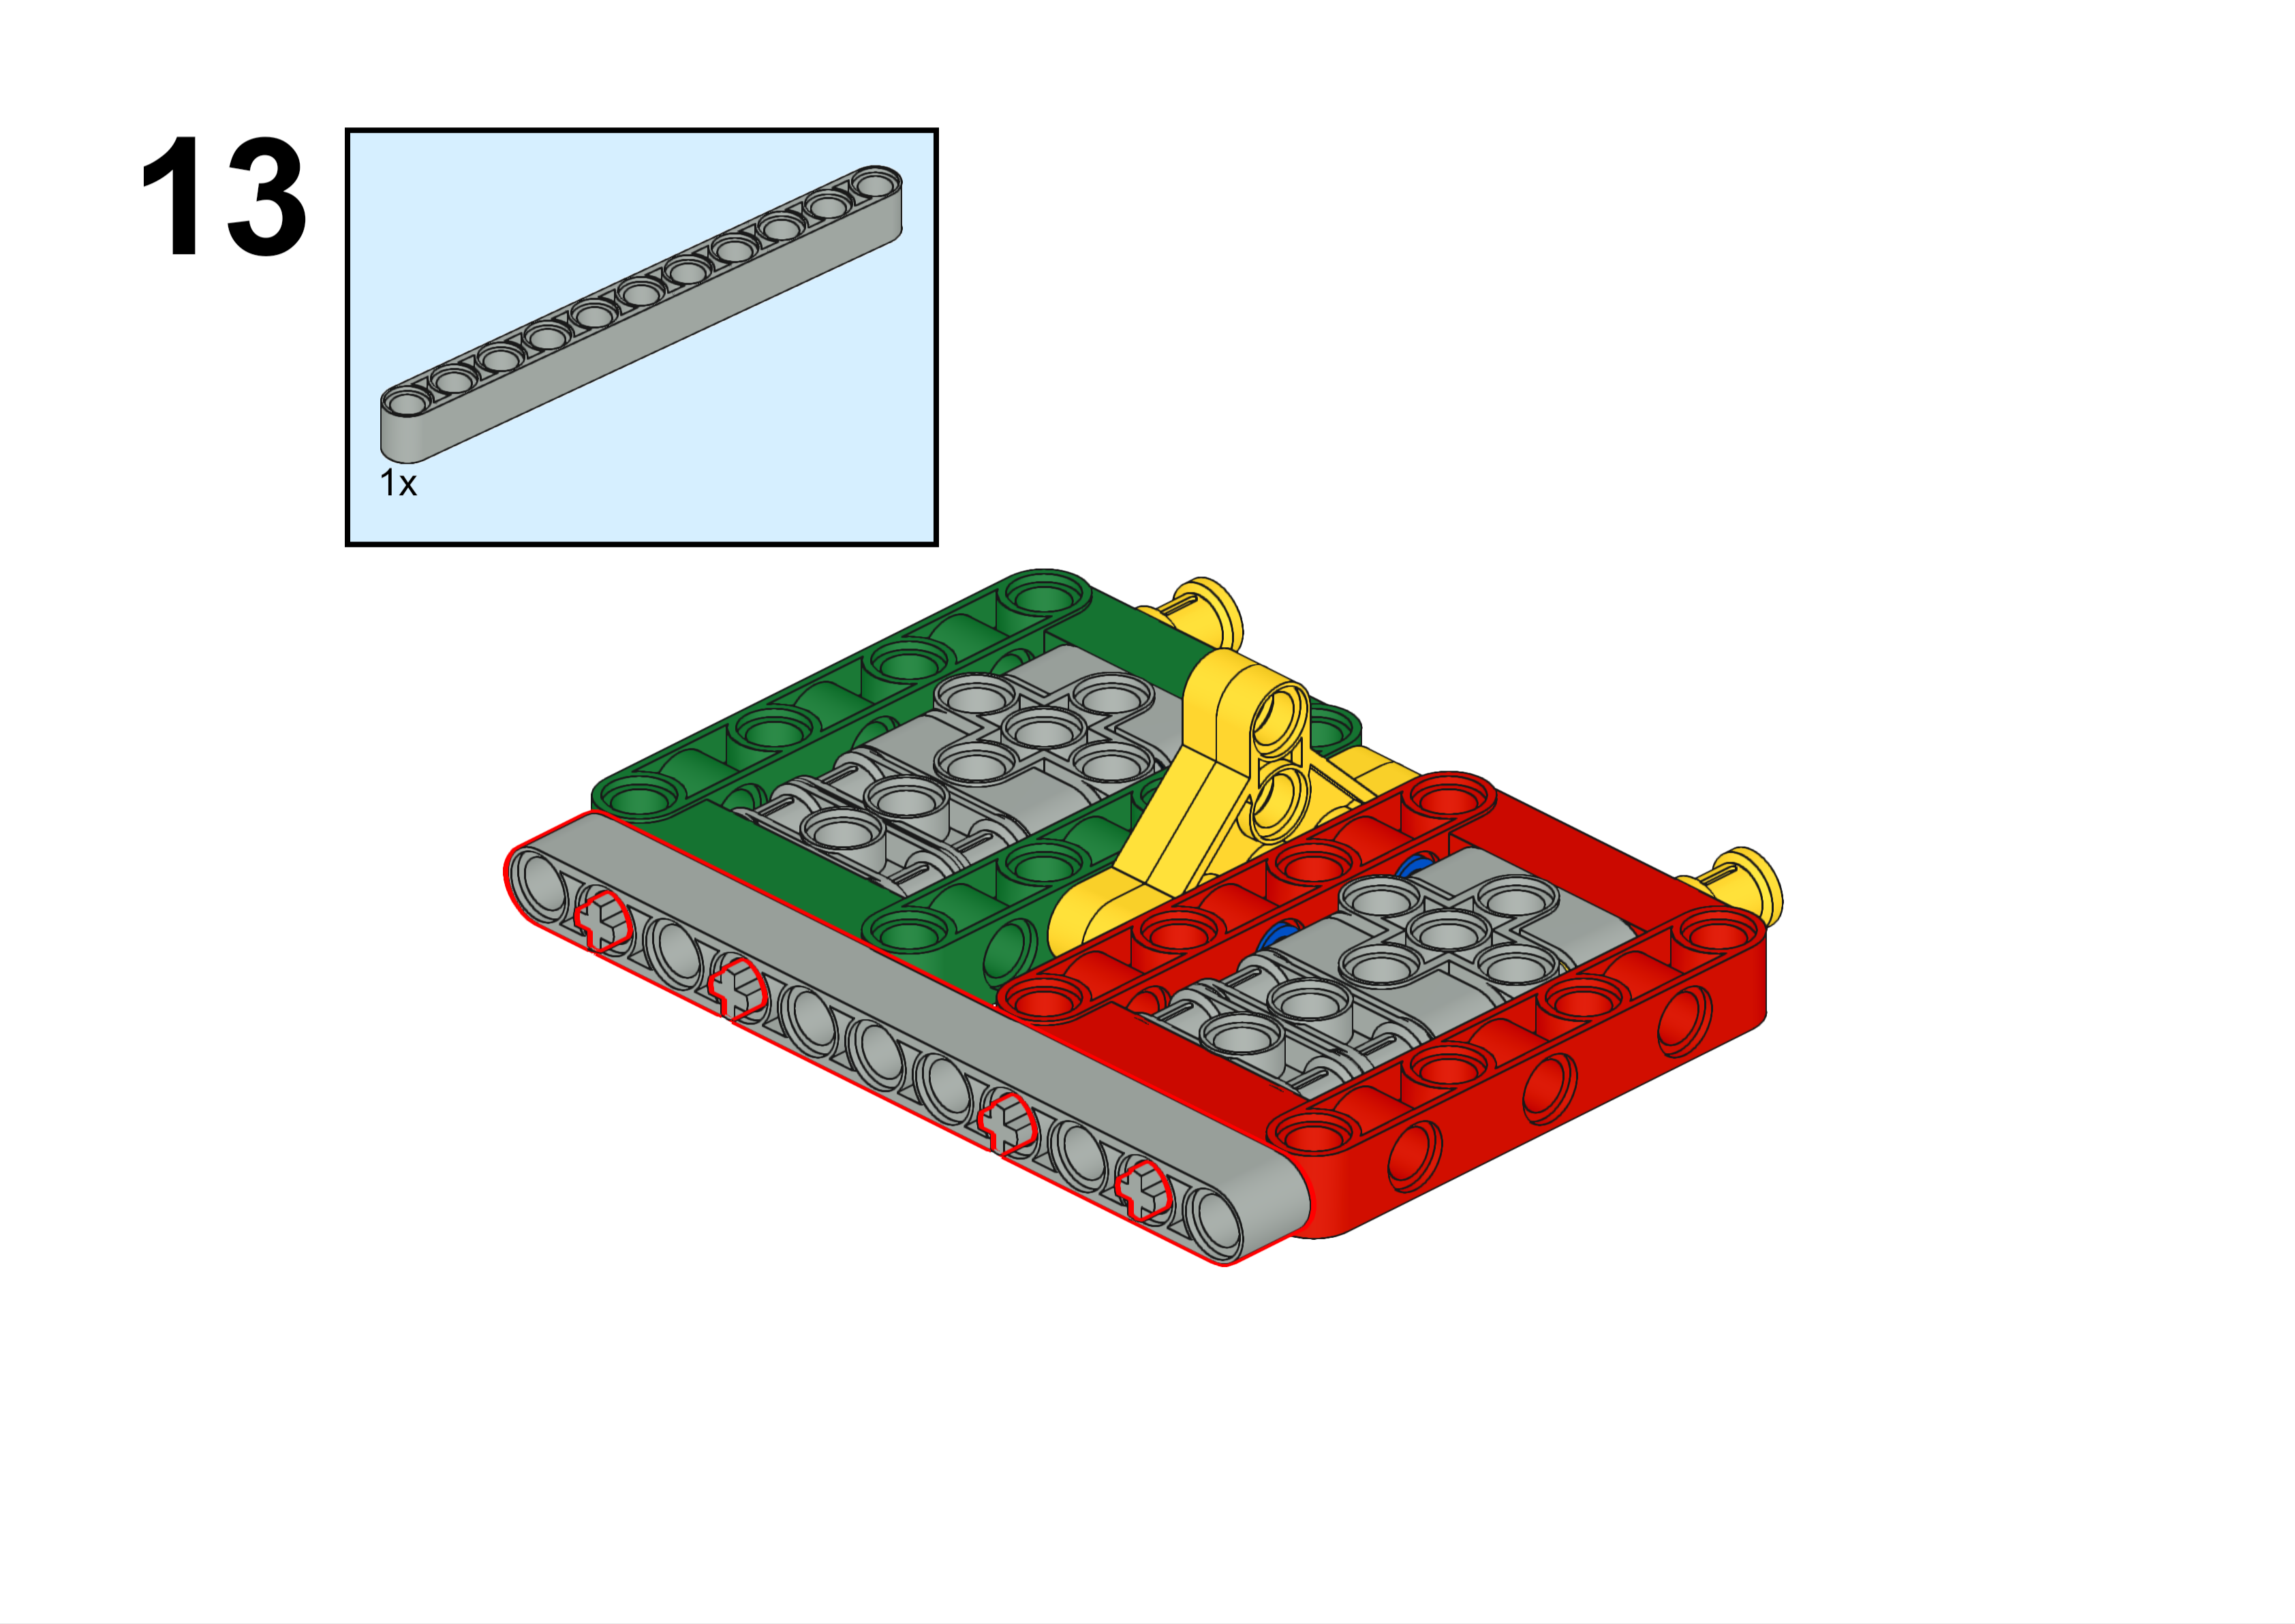

Slide 18


Slide 19
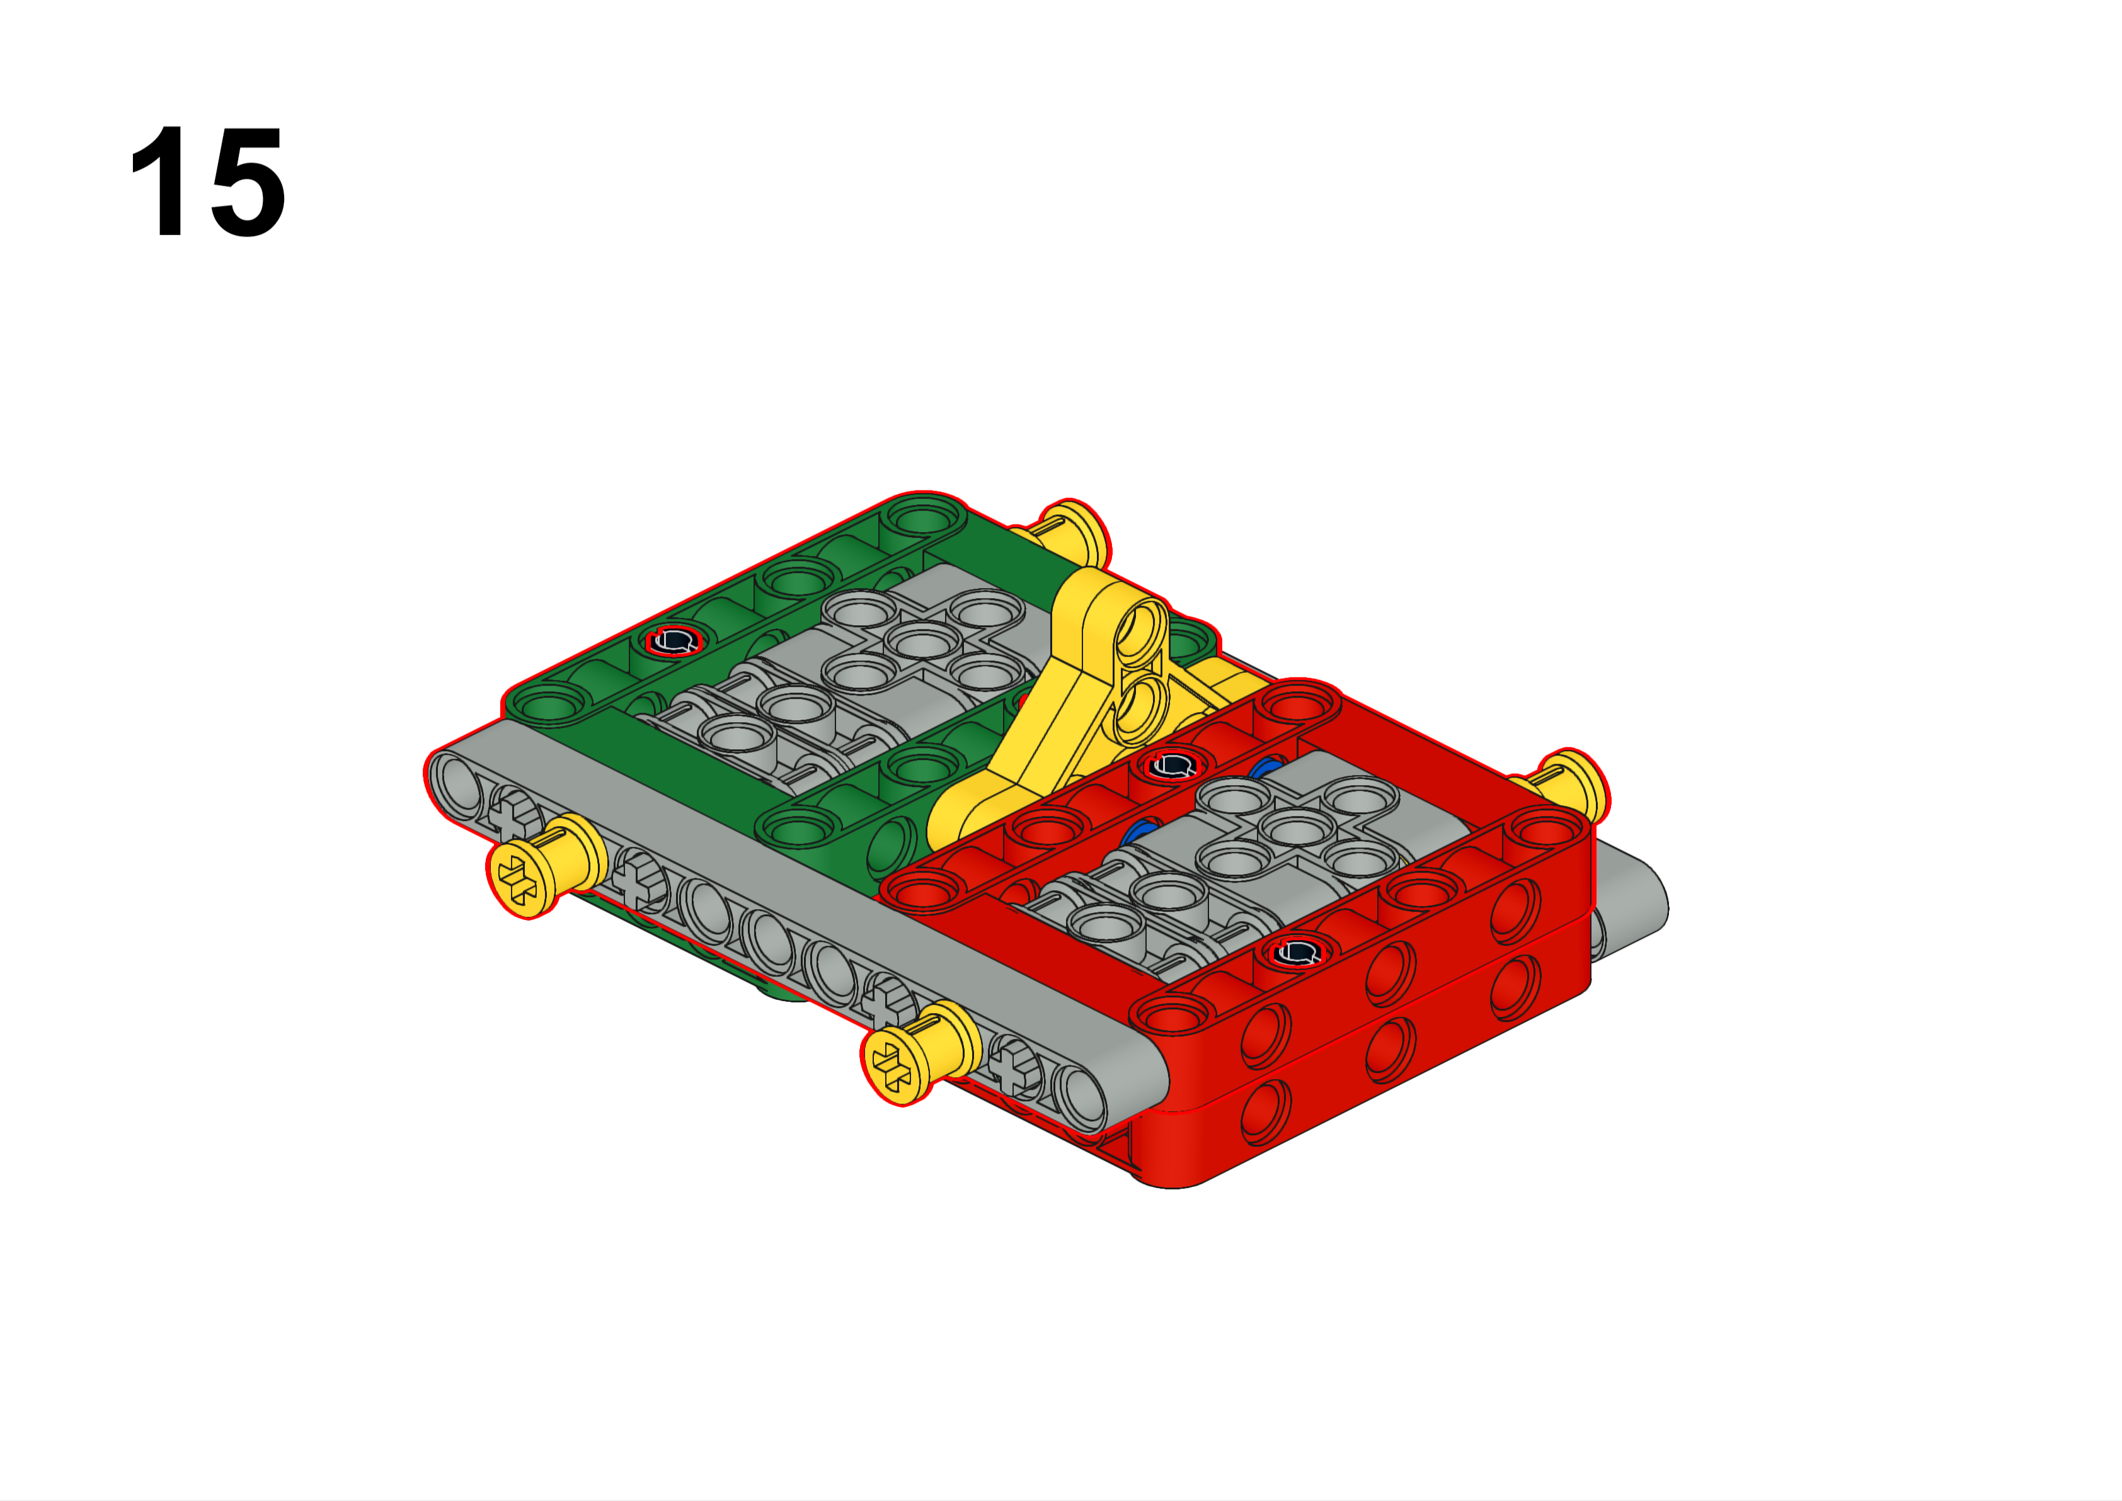

Slide 20
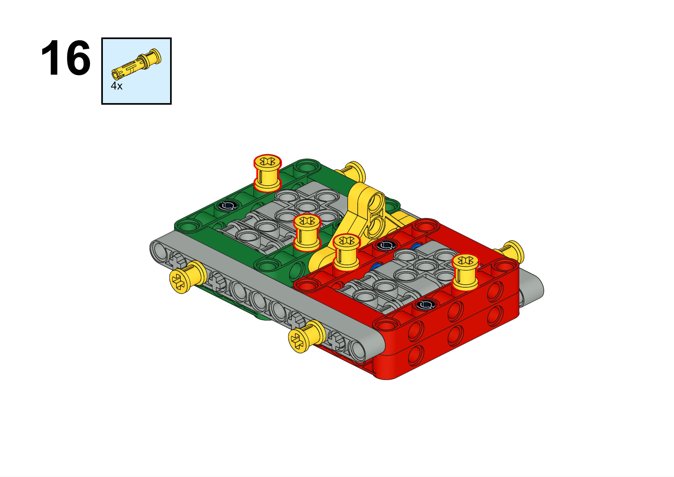

Slide 21
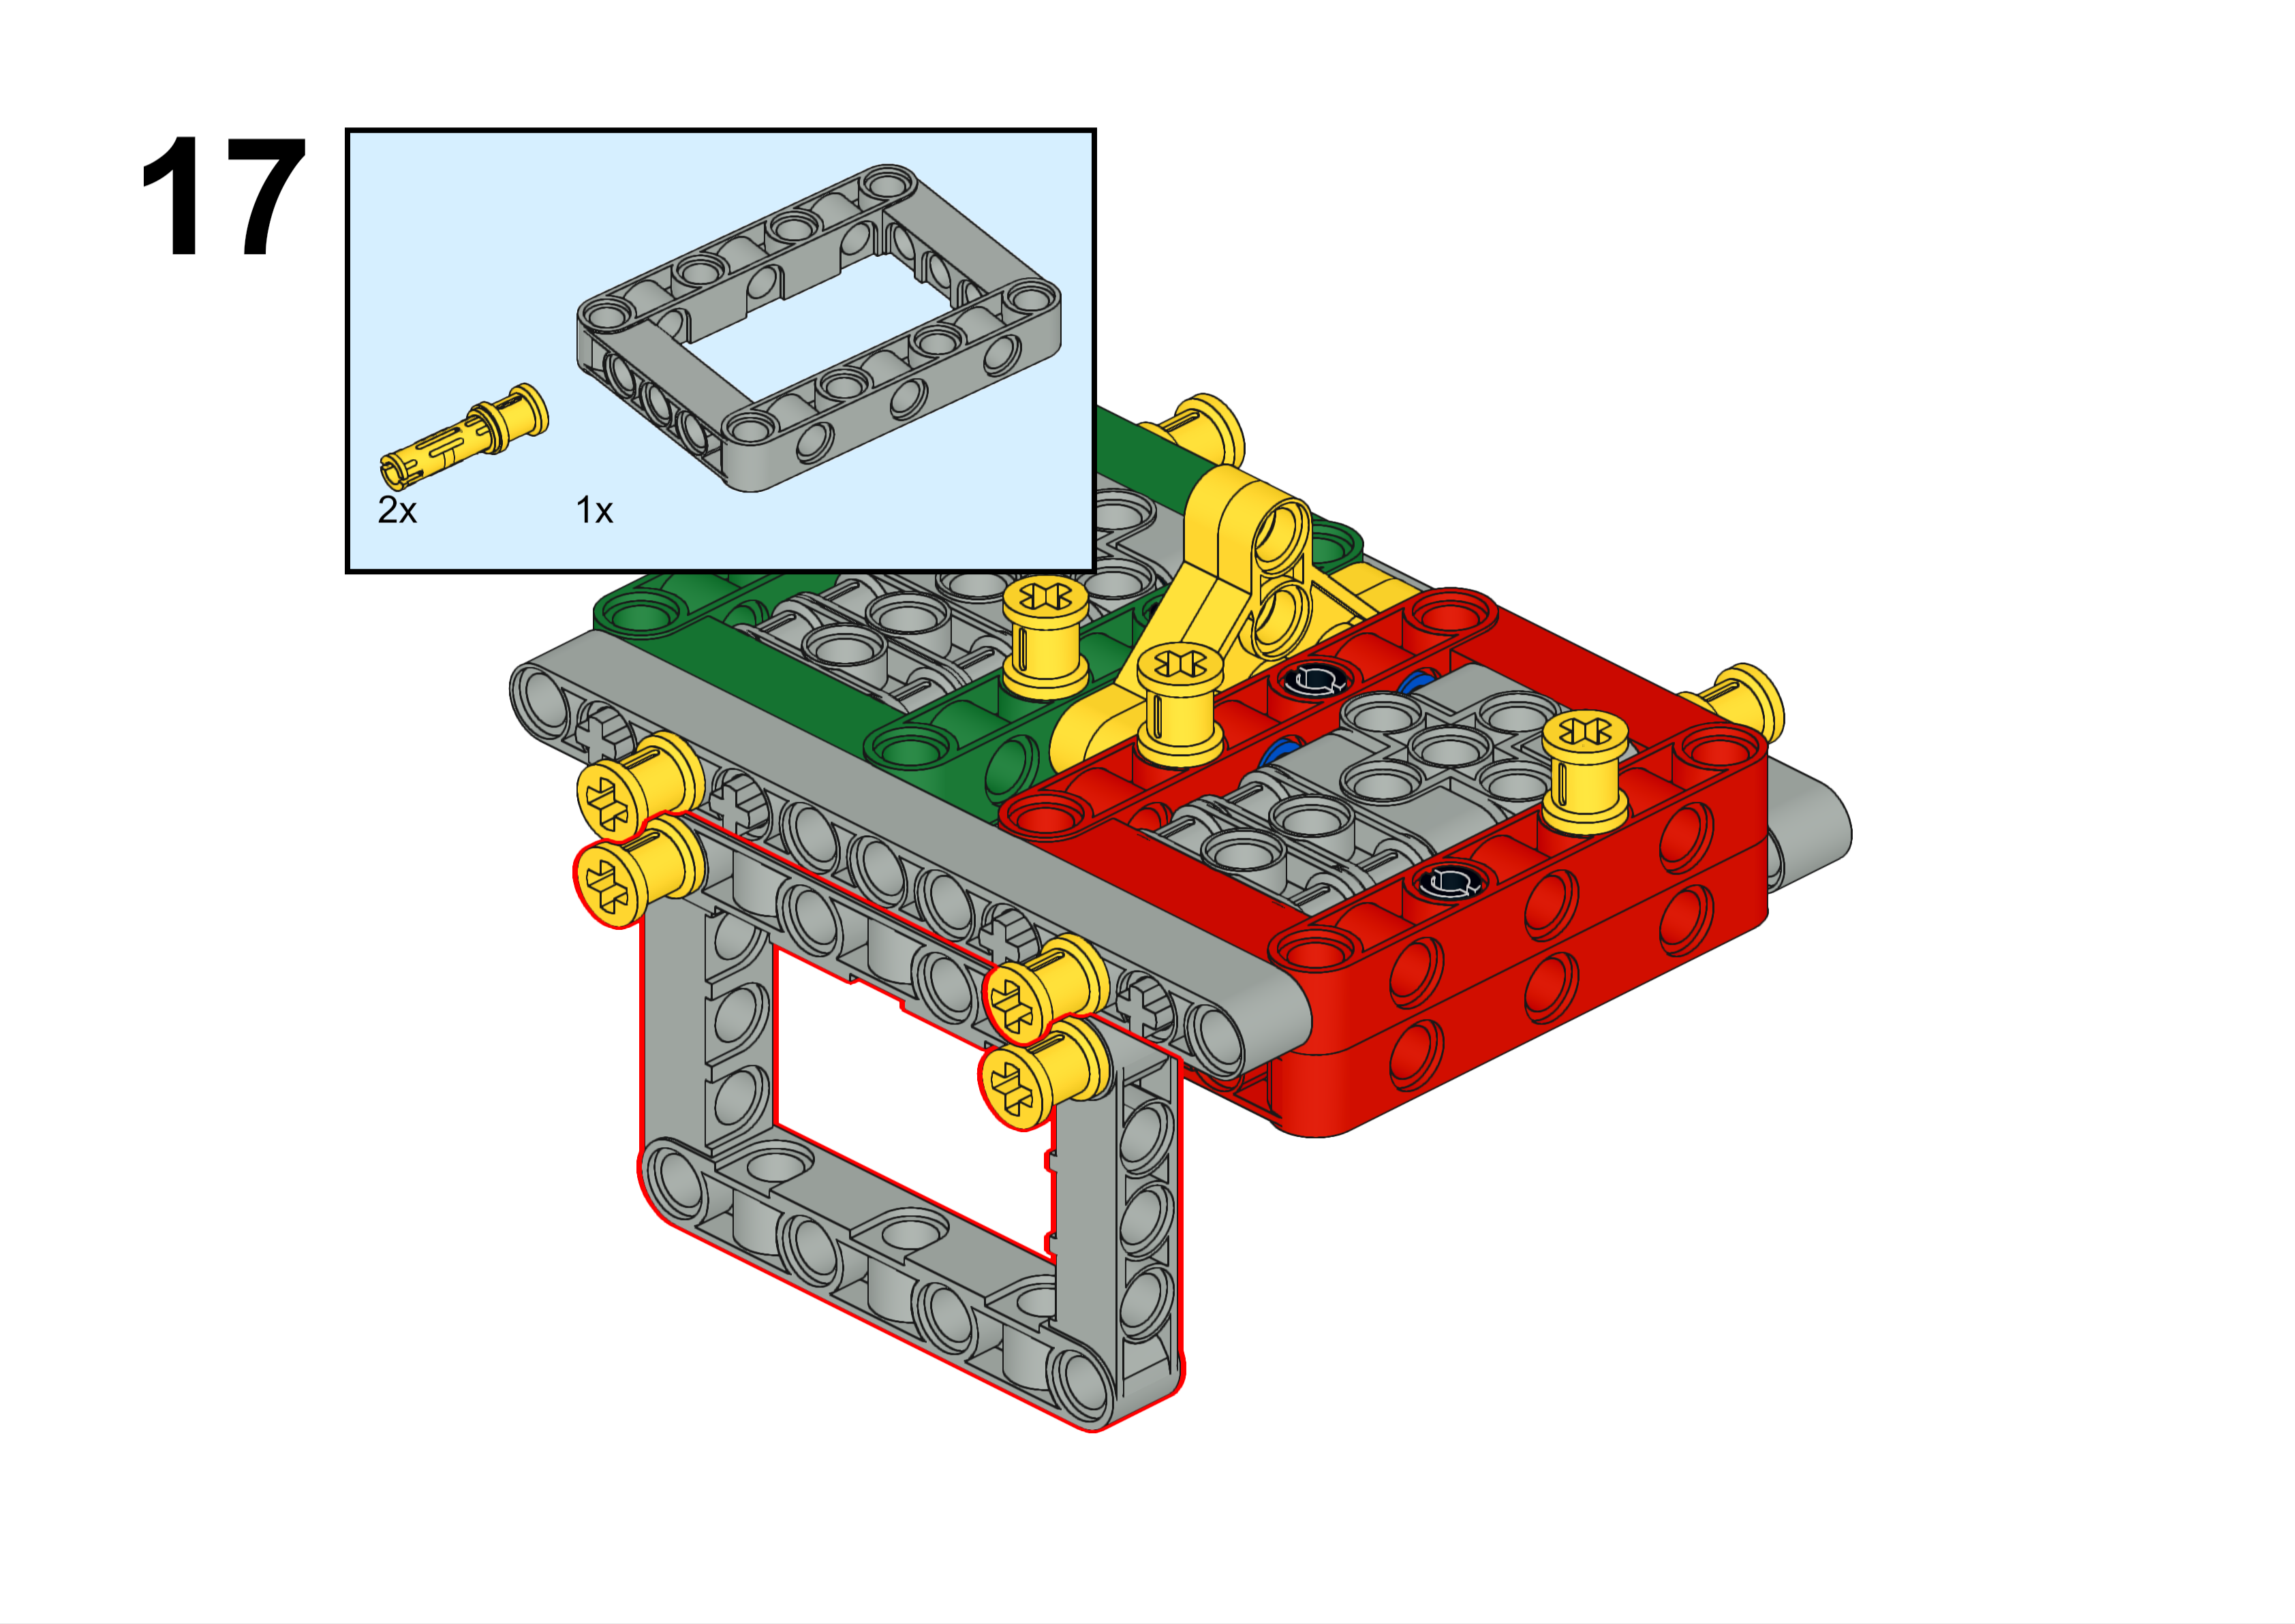
This frame is very important, but you may not fully understand its purpose until we get closer to the tournaments.

Slide 22
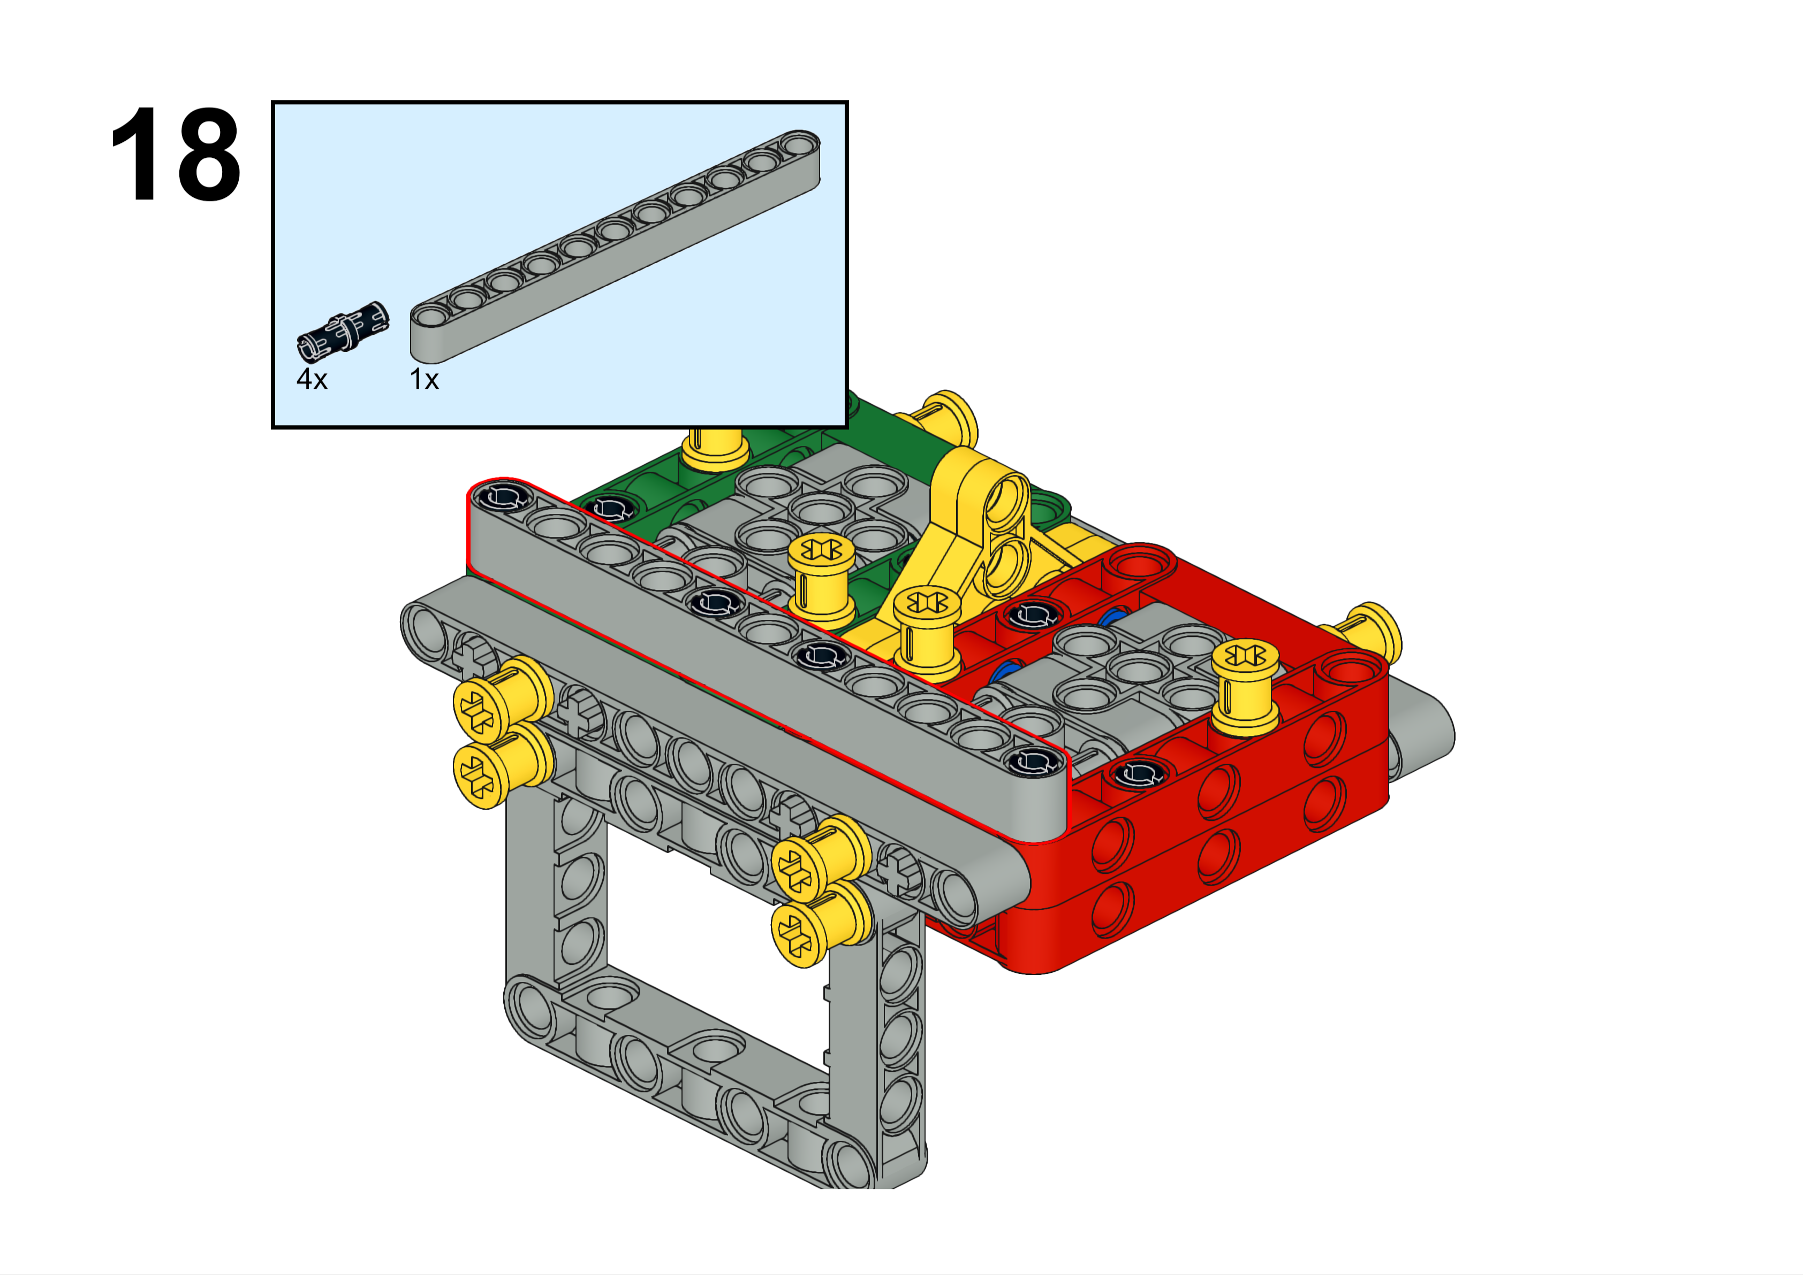

Slide 23
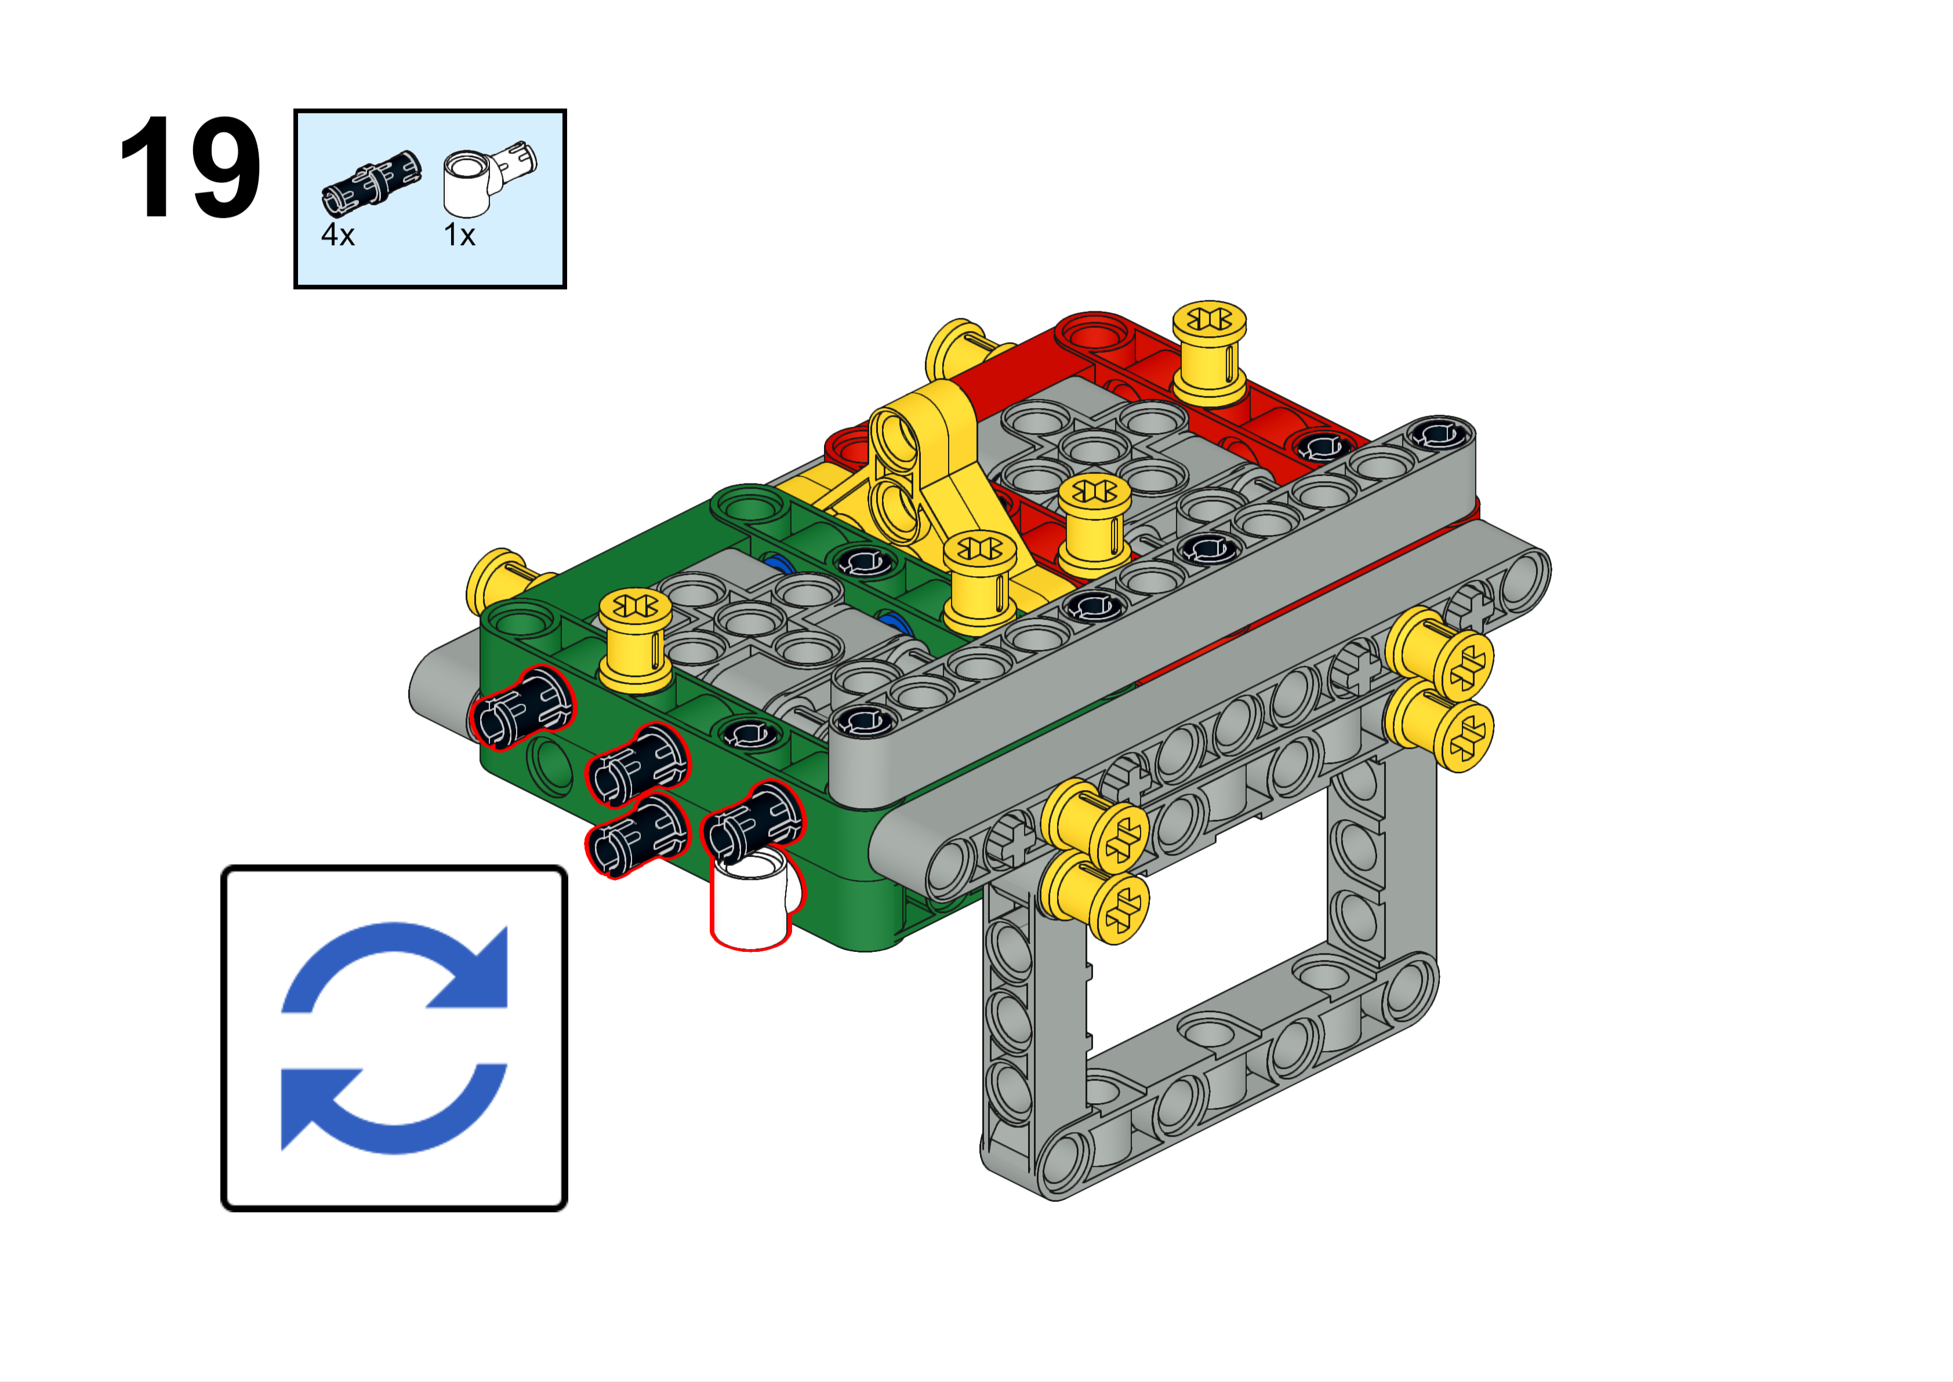
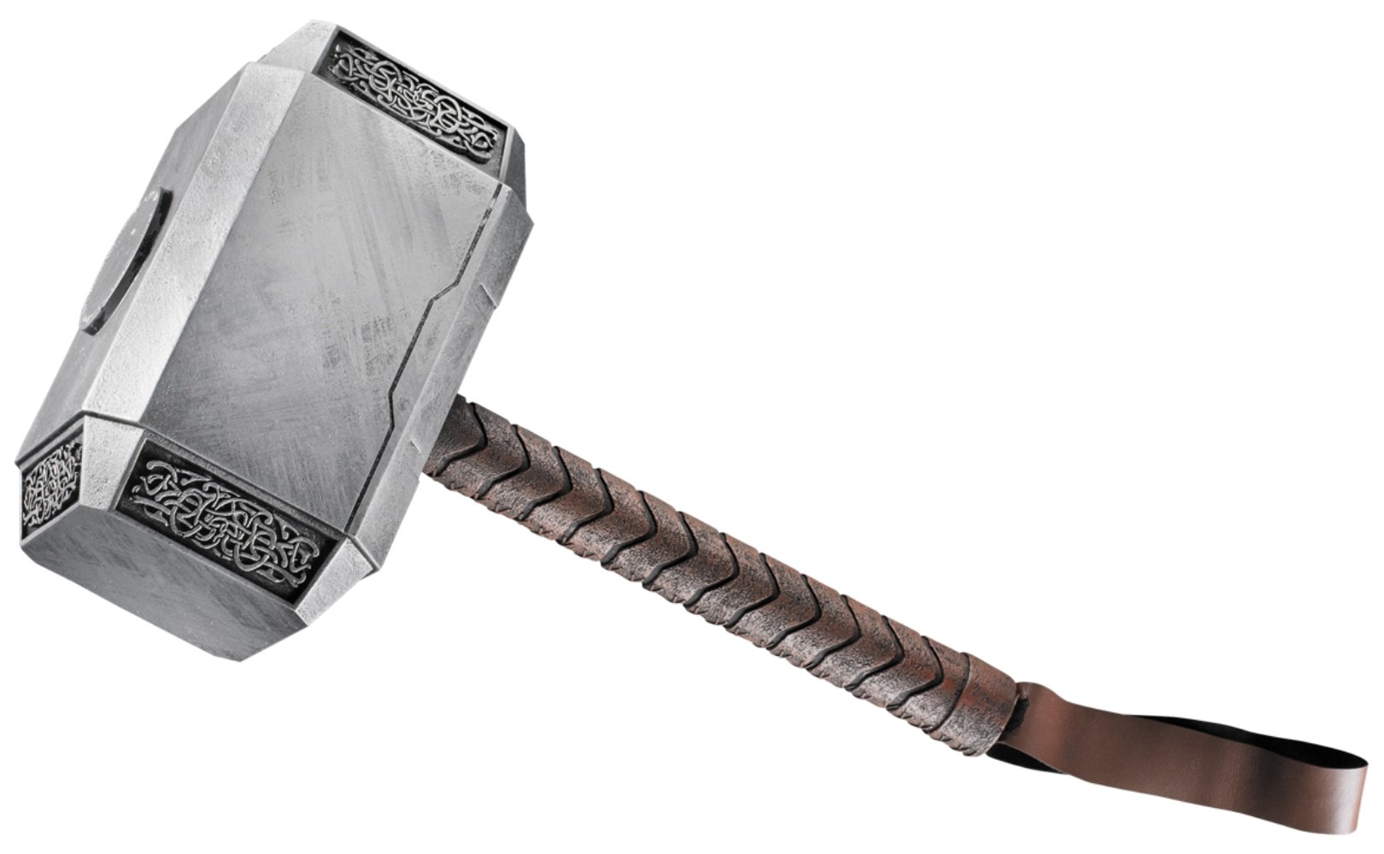
We call this white piece a “hammer”.

Slide 24
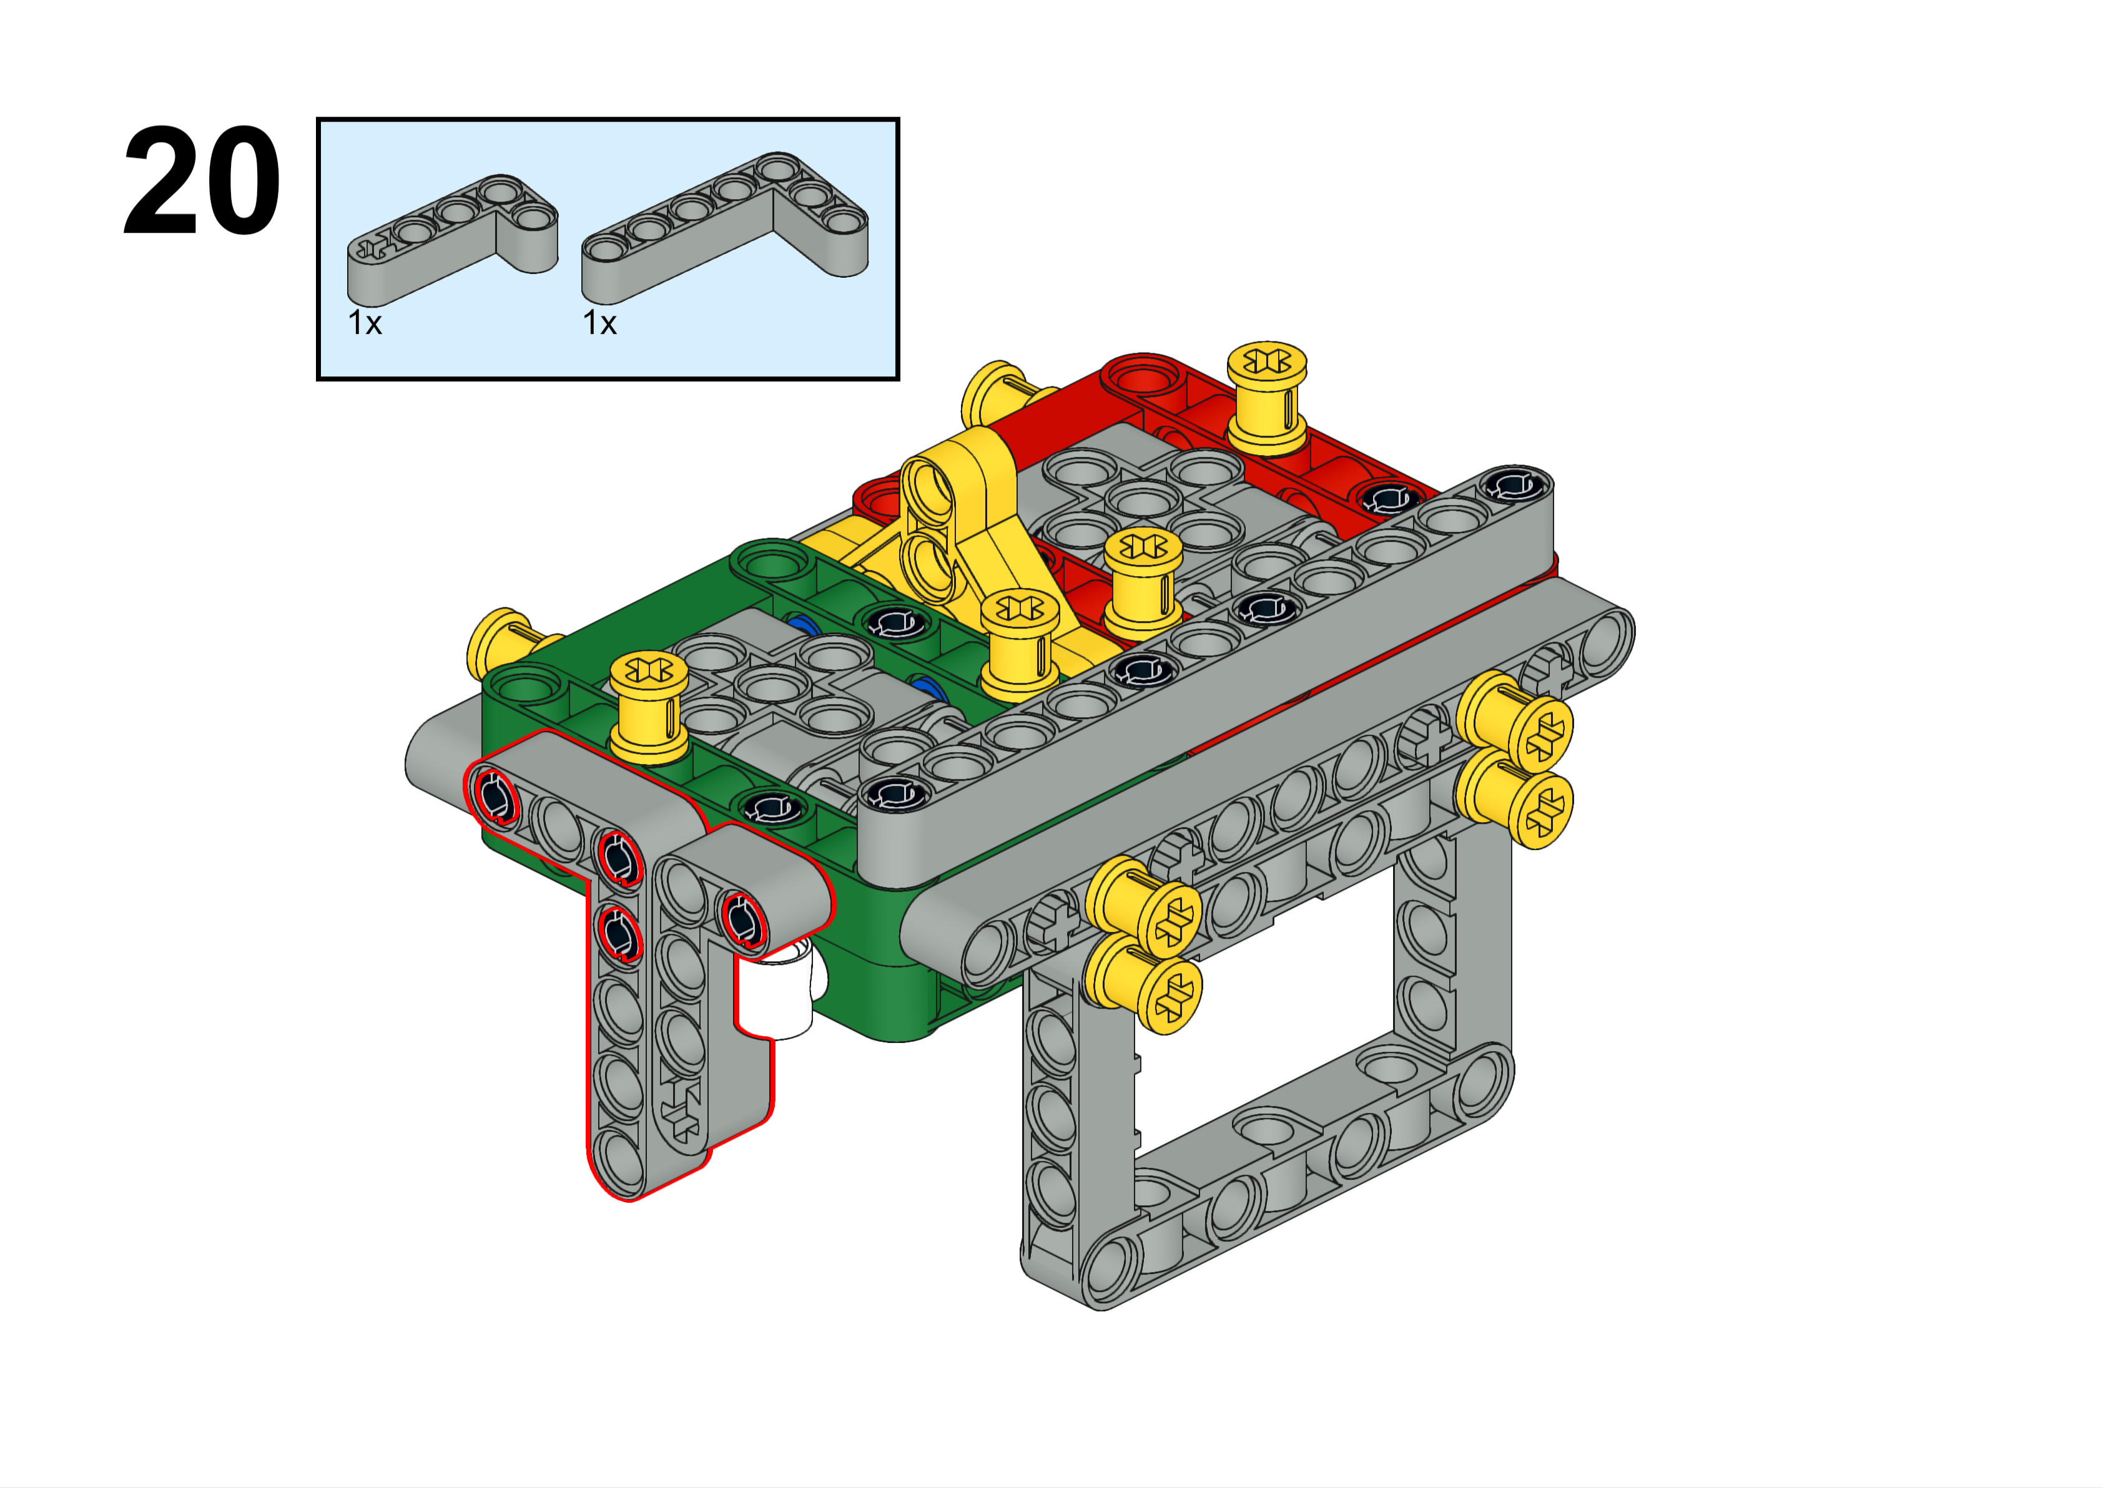

Slide 25
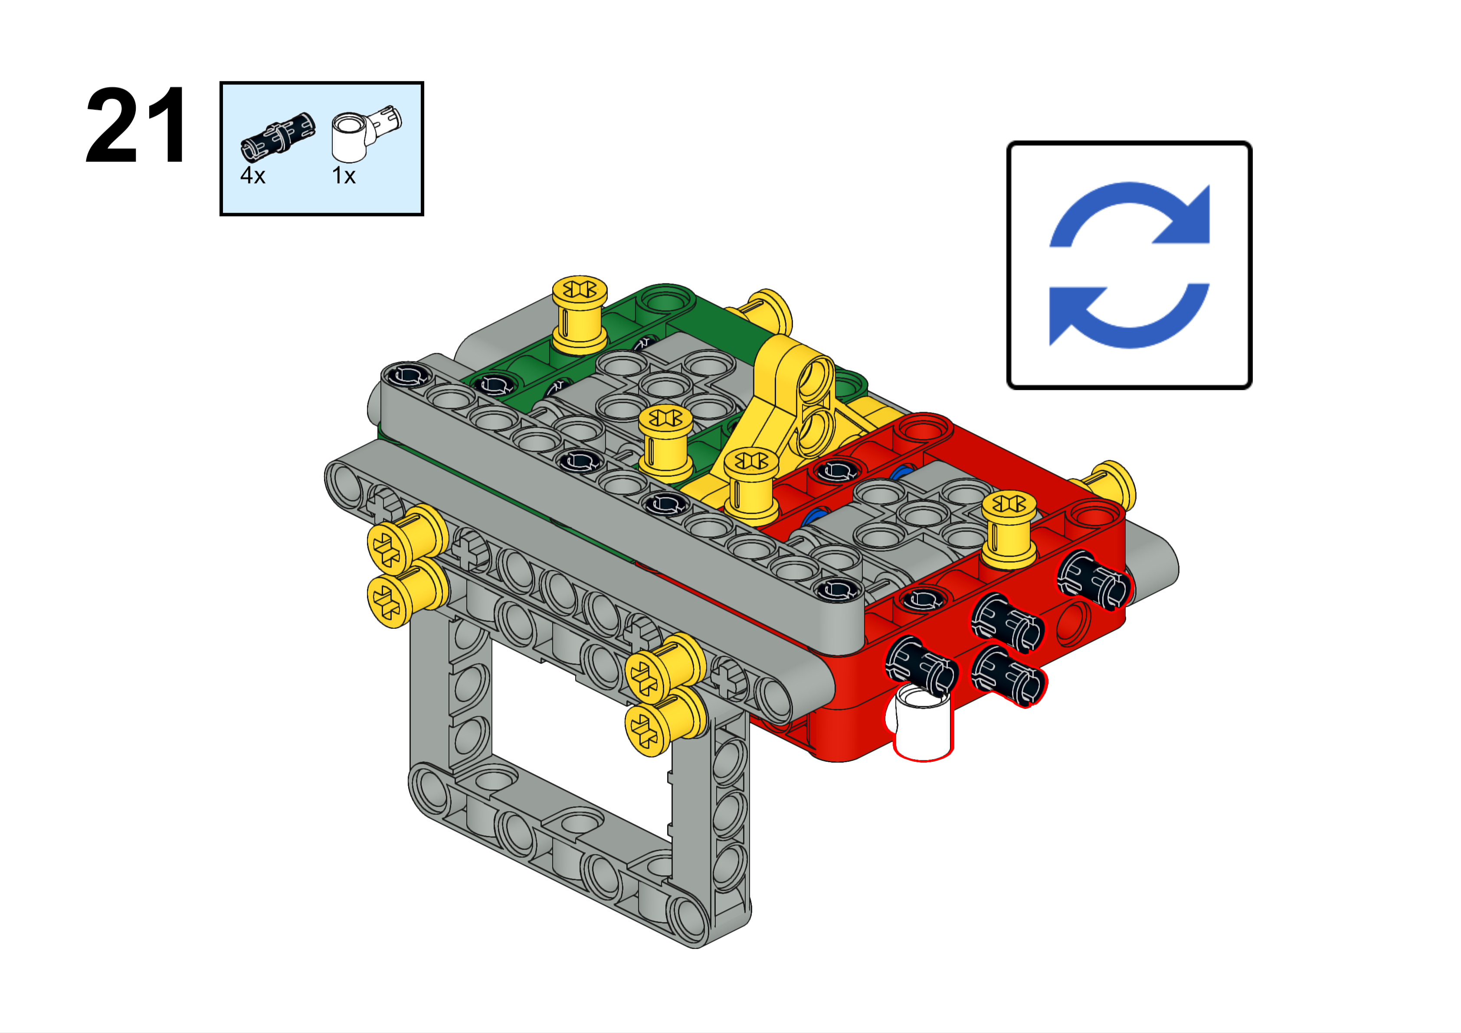

Slide 26
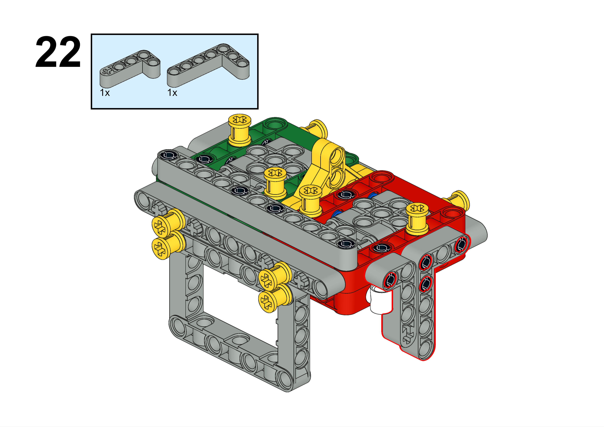

Slide 27
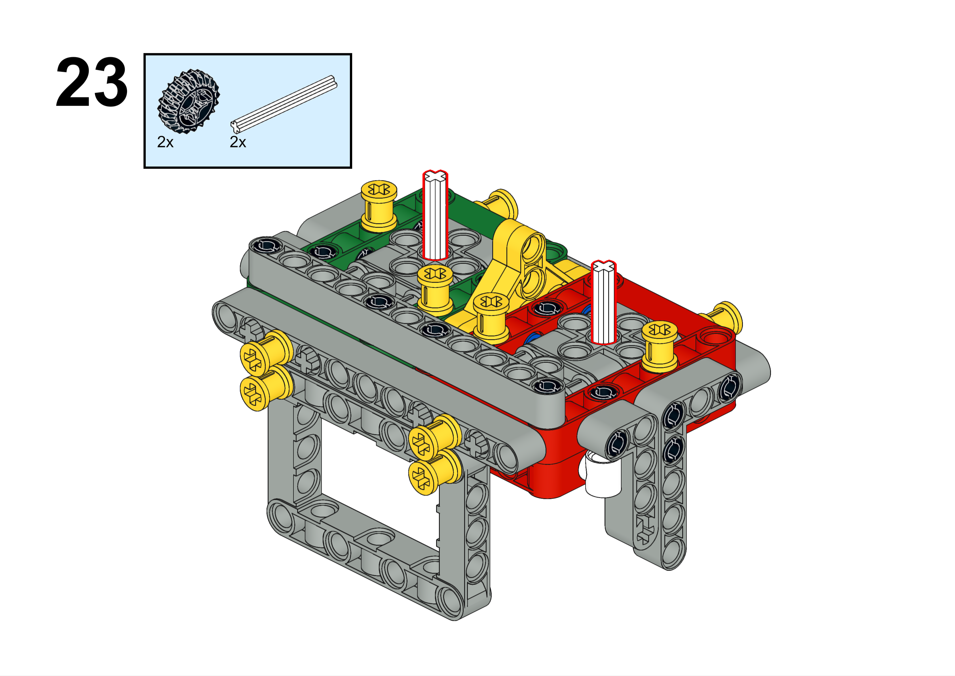

Slide 28
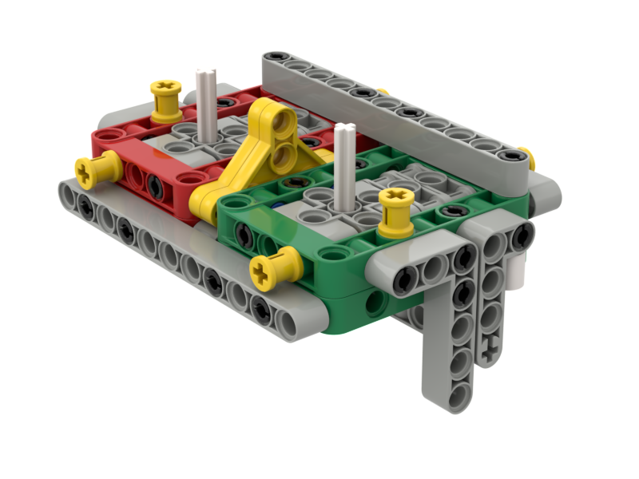
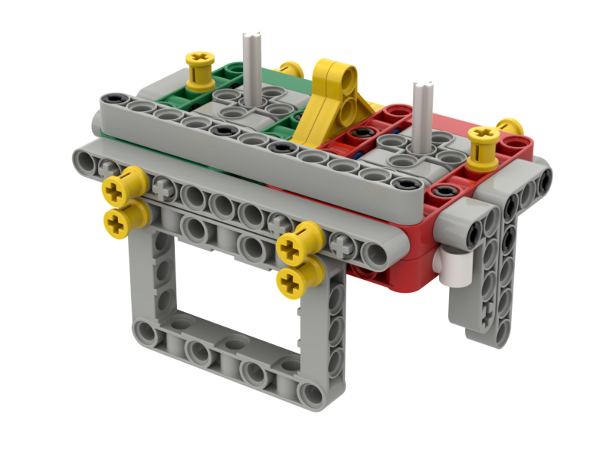
Done!
But not quite….
Please read Step 2 - Right Angle Attachments Introduction next

